Slide 1
The Revelation of Jesus Christ
A study of the book
of Revelation

Slide 2
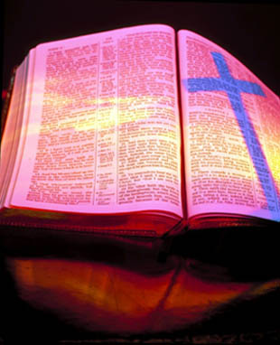
Revelation 12:1-17
“The sun-clad woman and
the great red dragon”

Slide 3
“And there appeared a great wonder in heaven; a woman clothed with the sun, and the moon under her feet, and upon her head a crown of twelve stars.”

Slide 4
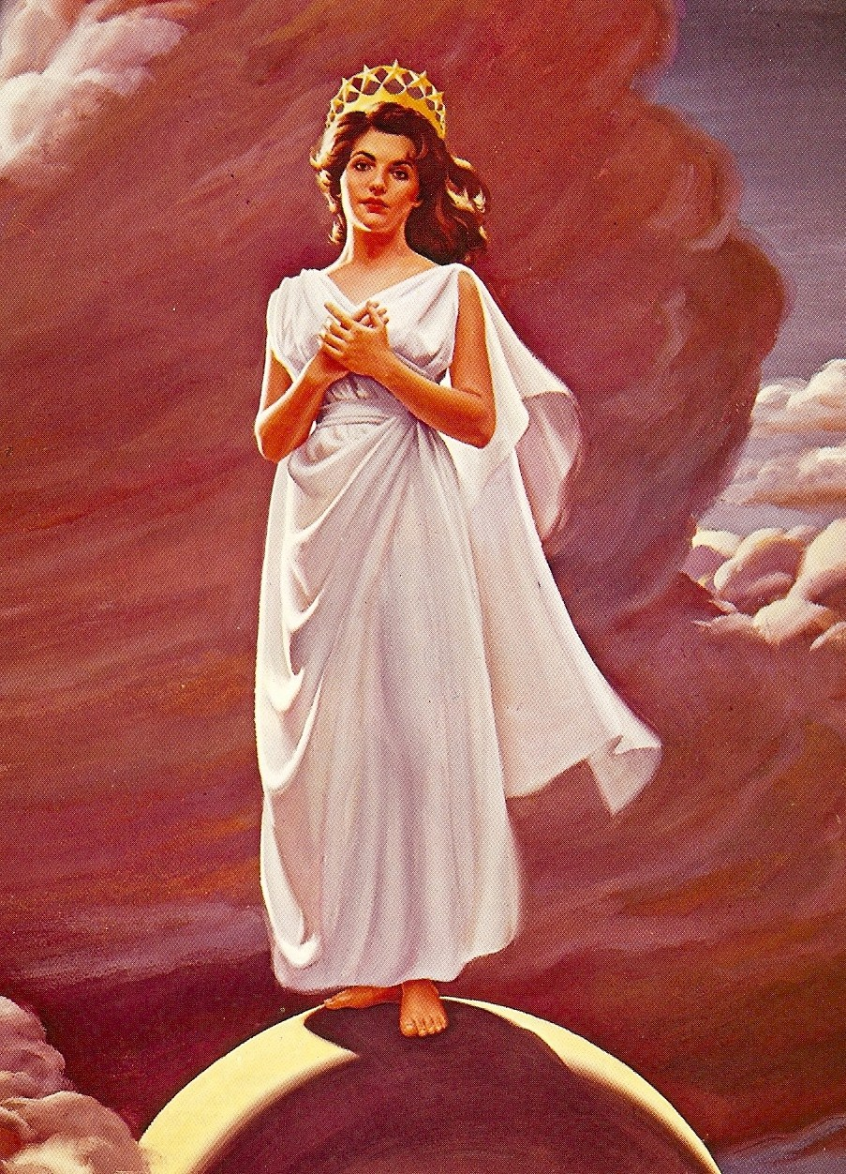
Great wonder (sign) in heaven
A woman
Clothed with the sun
Moon under her feet
Crown of 12 stars on her head

Slide 5
Who is this Woman?
Roman Catholic Church says that it is the “Virgin Mary” (Queen of Heaven)
Some Protestants say it is the “Church”
Note: The Church is seen as a woman “Bride of Christ” (II Corinthians 11:2; Ephesians 5:23-24). The woman here gives birth to a child, the Lord Jesus Christ. The Church did not give birth to Christ. Christ gave birth to the Church – Matthew 16:18

Slide 6
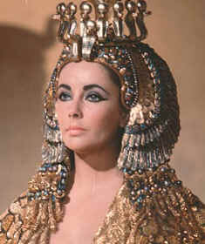
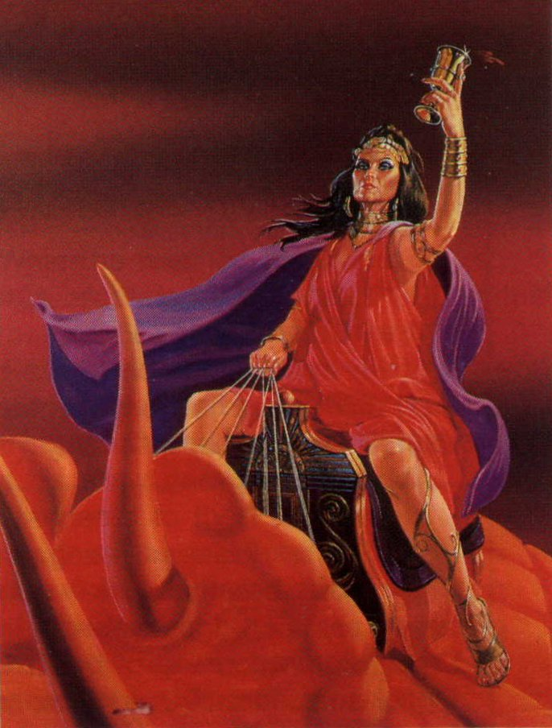
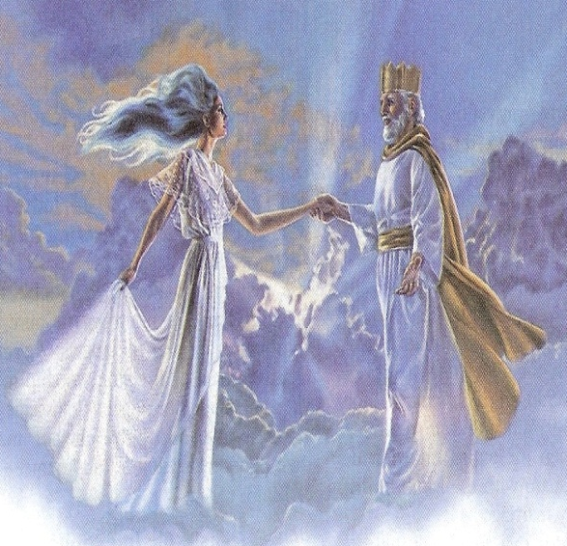
The Four Women of the Revelation
Jezebel represents paganism and worldliness - 2:20
Scarlet woman (whore) represents the apostate church – 17:1
Lamb’s wife represents the true Church – 19:7
Israel – 12:6

Slide 7
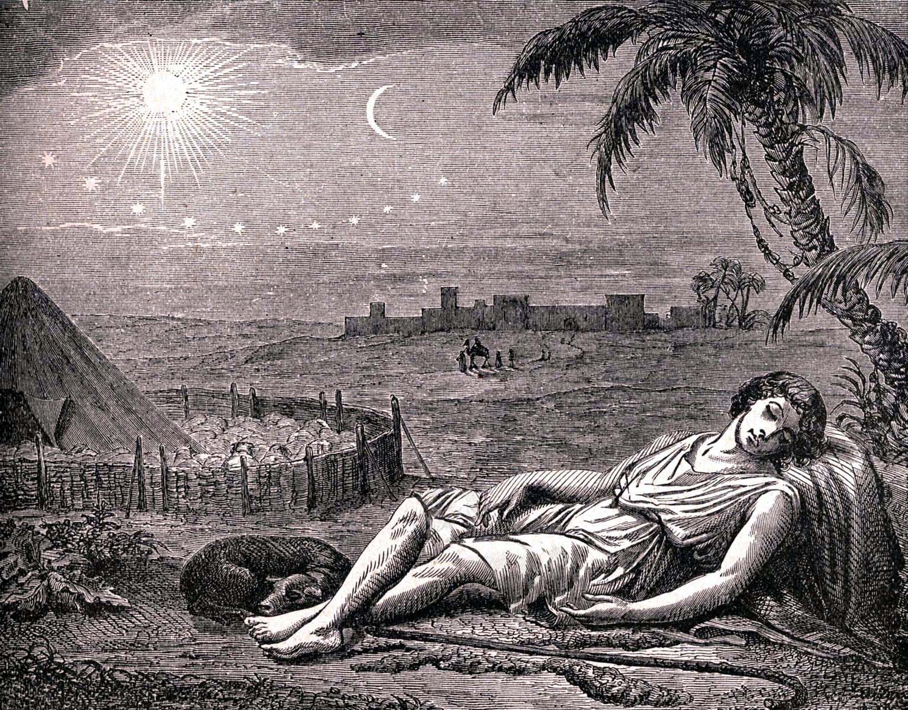
Joseph’s Dream
(Genesis 37:9-11)
Sun = Father
Moon = Mother
Stars = Brothers
The nation of Israel
Romans 9:5 “Of whom as concerning the flesh Christ came.”

Slide 8
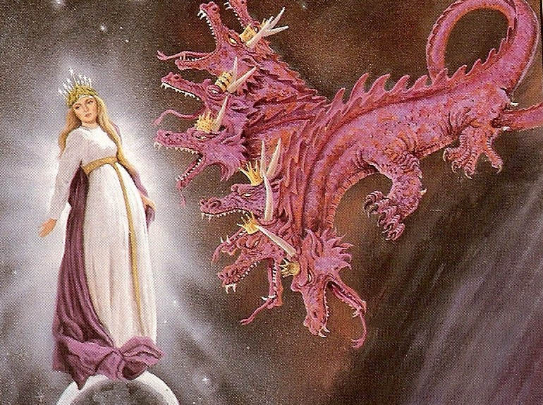
“And she being with child cried, travailing in birth, and pained to be delivered. And there appeared another wonder in heaven; and behold a great red dragon, having seven heads and ten horns, and seven
crowns upon his heads.”

Slide 9
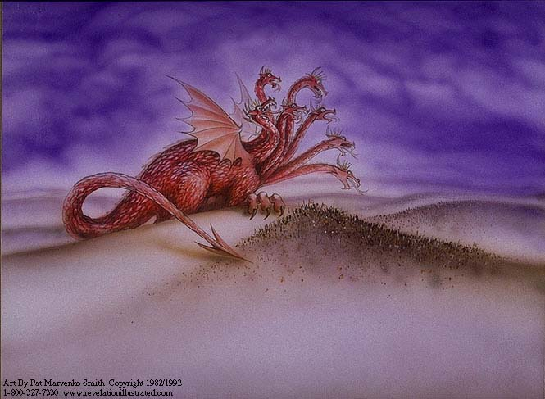
The Great Red Dragon “That old serpent called the Devil, and Satan, which deceiveth the whole world.” (Revelation 12:9)
Red = Murderous character (John 8:44)
Seven heads = Complete in intelligence (Ezekiel 28:12) “full of wisdom”
Ten horns = Great power (II Corinthians 4:4)
Seven crowns = Rule and authority (Ephesians 2:2)

Slide 10
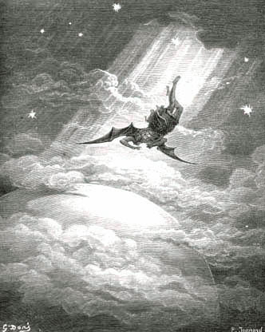
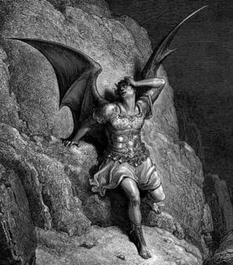
Satan a Fallen Star (angel) Five foolish and fatal “I will’s” of the devil (Isaiah 14:12-14)
I will ascend into heaven
I will exalt my throne above the stars of God
I will sit also upon the mount of the congregation, in the sides of the north
I will ascend above the heights of the clouds
I will be like the most High

Slide 11
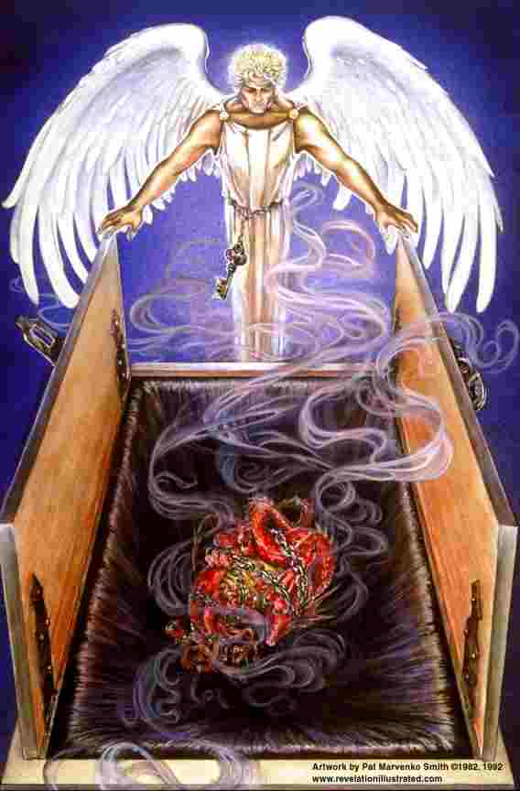
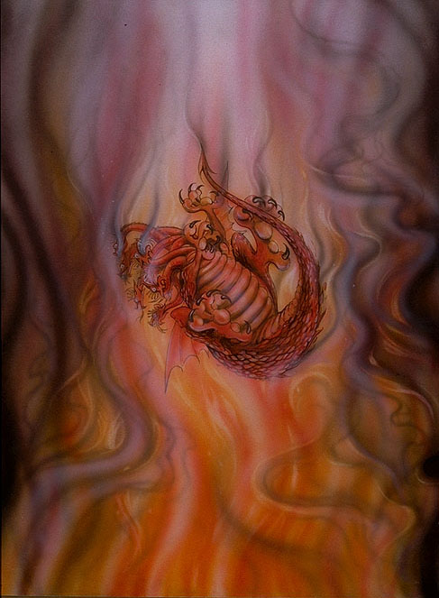
“Thou wast perfect in thy ways from the day that thou wast created, till iniquity was found in thee. By the multitude of thy merchandise they have filled the midst of thee with violence, and thou hast sinned: therefore I will cast thee as profane out of the mountain of God: and I will destroy thee, O covering cherub, from the midst of the stones of fire. Thine heart was lifted up because of thy beauty, thou hast corrupted thy wisdom by reason of thy brightness: I will cast thee to the ground, I will lay thee before kings, that they may behold thee. Thou hast defiled thy sanctuaries by the multitude of thine iniquities, by the iniquity of thy traffic; therefore will I bring forth a fire from the midst of thee, it shall devour thee, and I will bring thee to ashes upon the earth in the sight of all them that behold thee. All they that know thee among the people shall be astonished at thee: thou shalt be a terror, and never shalt thou be any more.” (Ezekiel 28:15-19)

Slide 12
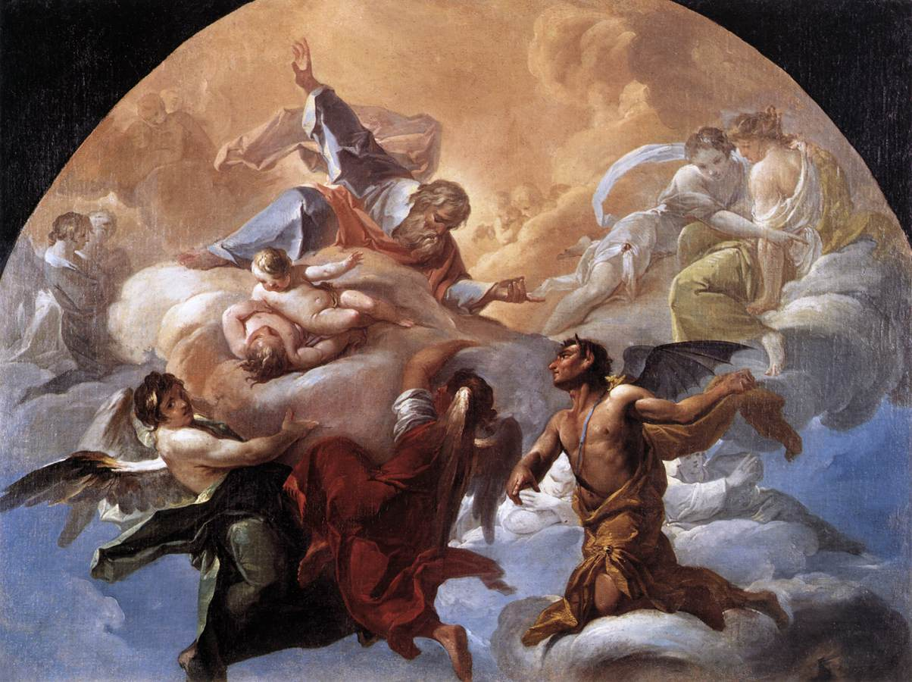
Satan our Great Adversary (I Peter 5:8)
Devil (slander)
Prince of the power of the air
God of this age
Spirit that worketh in the children of disobedience
King of death
Enemy
Prince of this world
Ruler of darkness
Angel of light
Liar
Murder
Leviathan
Lucifer
Dragon
Deceiver
Apollyon
Beelzebub
Belial
Wicked one
Tempter
Accuser of the brethren
Roaring lion

Slide 13
“Tail drew a third part of the stars of heaven, and did cast them to the earth…”
Stars of heaven = Fallen angels
1/3 followed Satan in his rebellion
Isaiah 14:12-15; Ezekiel 28:12-16; II Peter 2:4; Jude 6

Slide 14
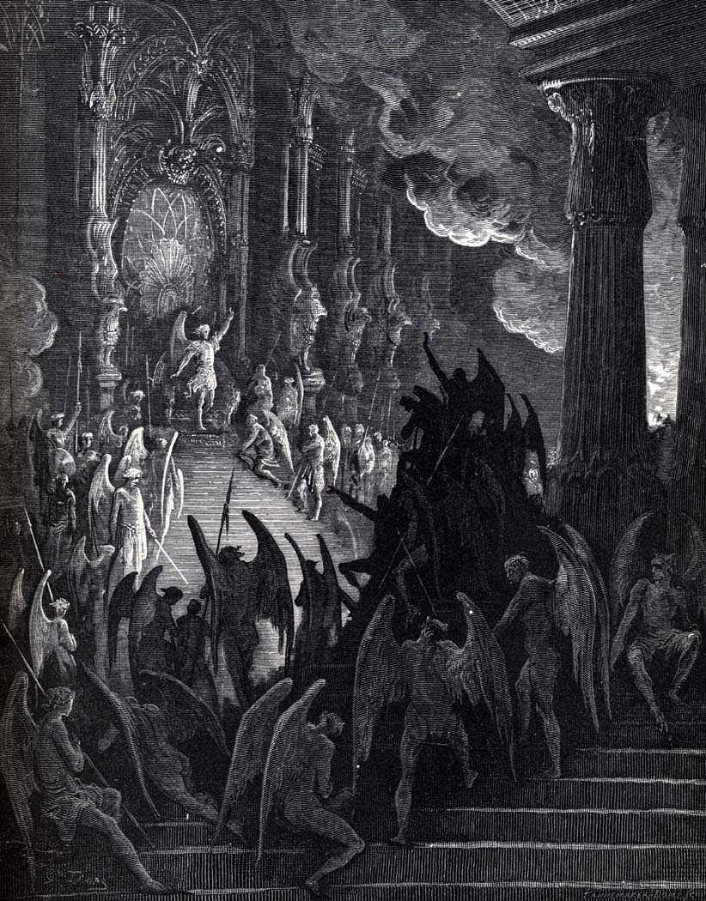

Slide 15
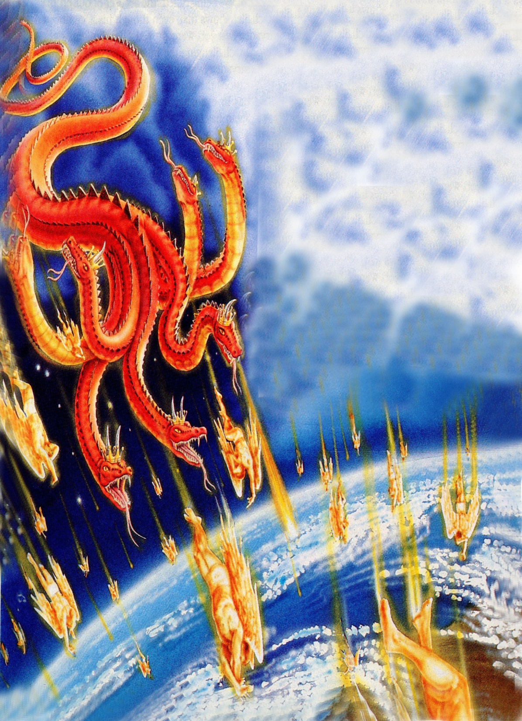
“And did cast them to the earth…”

Slide 16
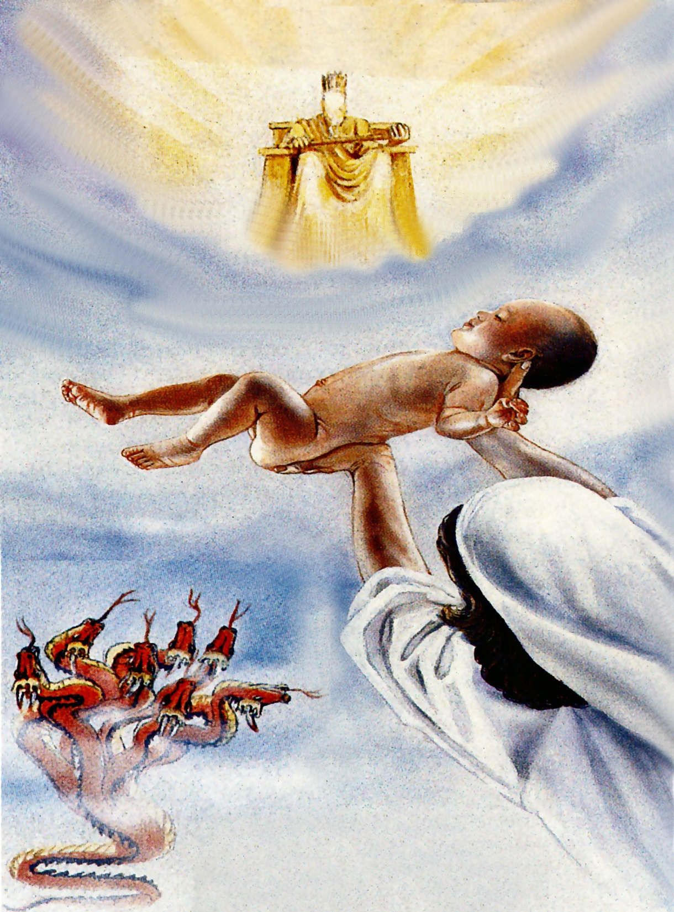
“The dragon stood before the woman which was ready to be delivered, for to devour her child as soon as it was born.”
Satan and his demons were ready to kill the Christ’s child upon His birth (Matthew 2:13-18)

Slide 17
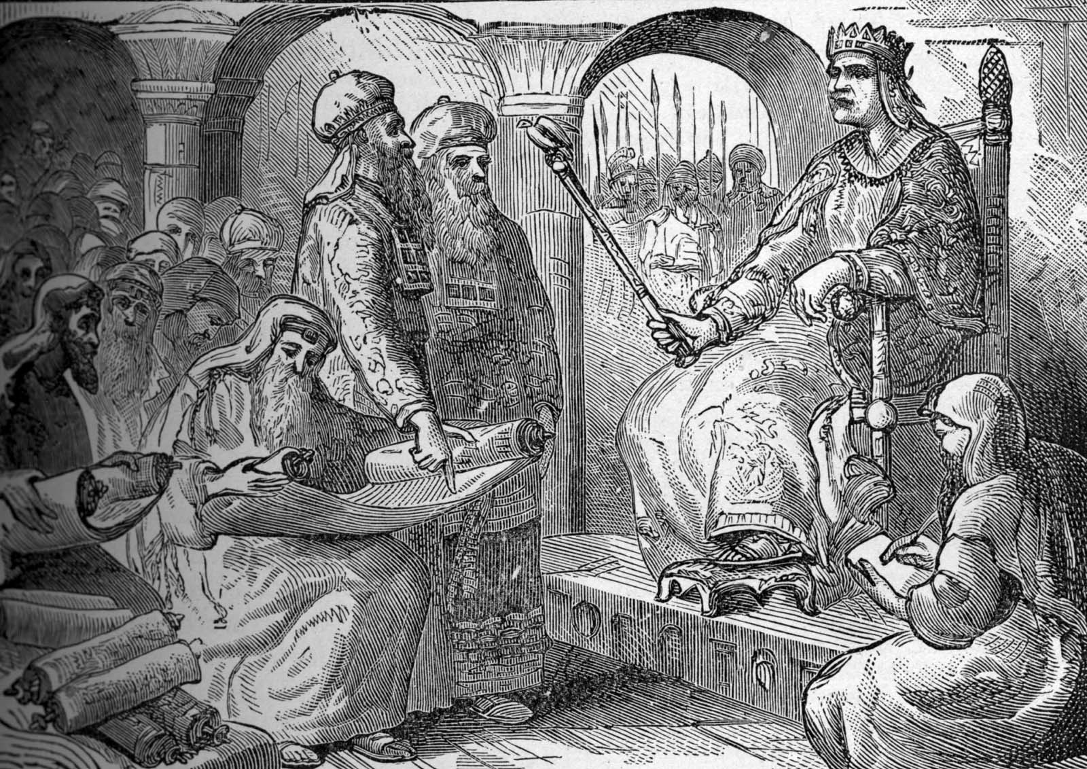
“Search diligently for the young child; and when ye have found him, bring me word again, that I may come and worship him.”

Slide 18
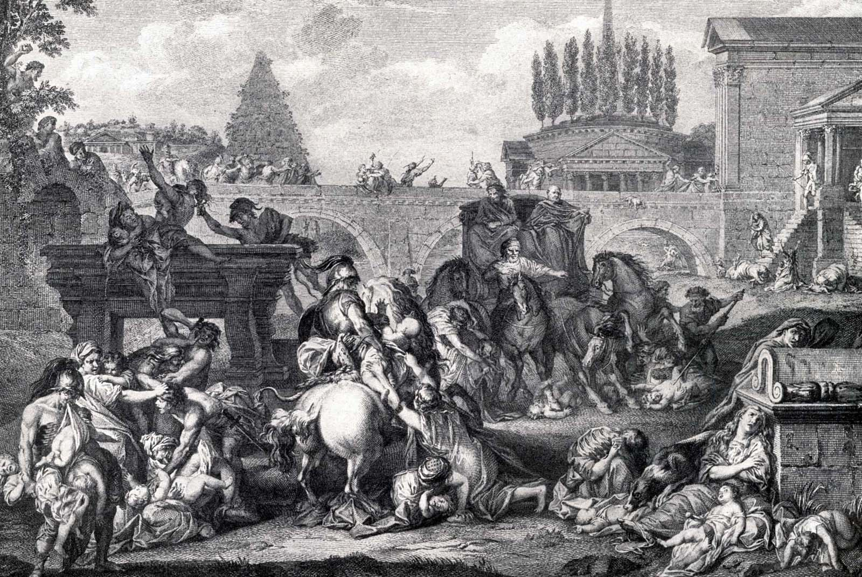
“And when he saw that he was mocked of the wise men, was exceeding wroth, and sent forth, and slew all the children that were in Bethlehem, and in all the coasts there of, from two years old and under.”

Slide 19
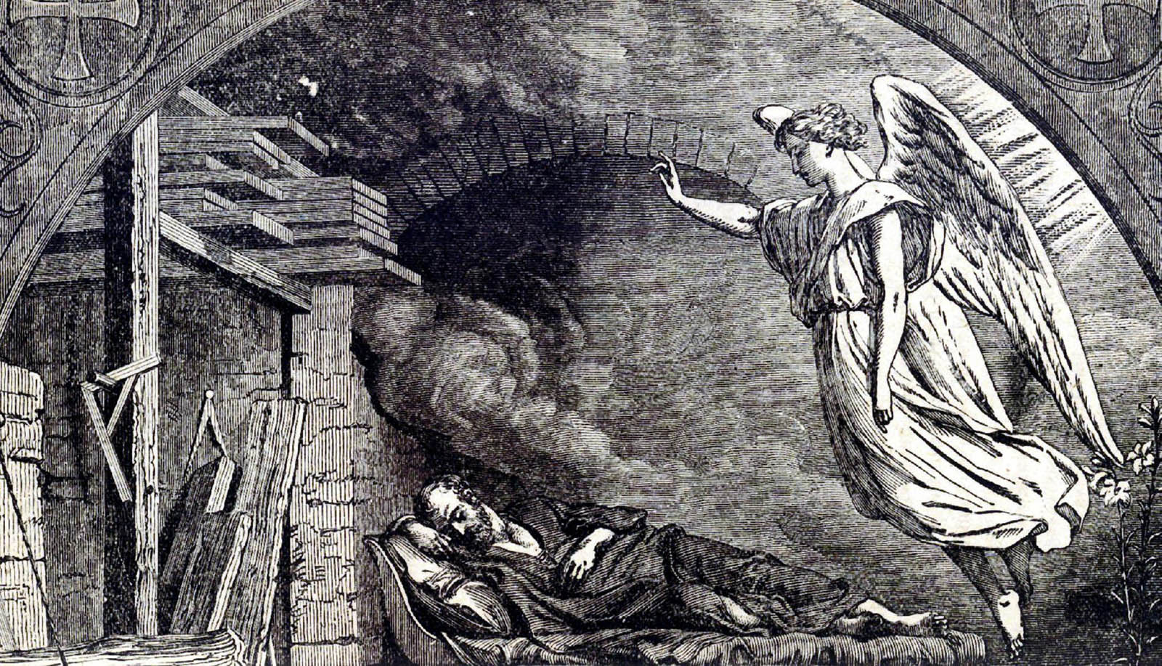
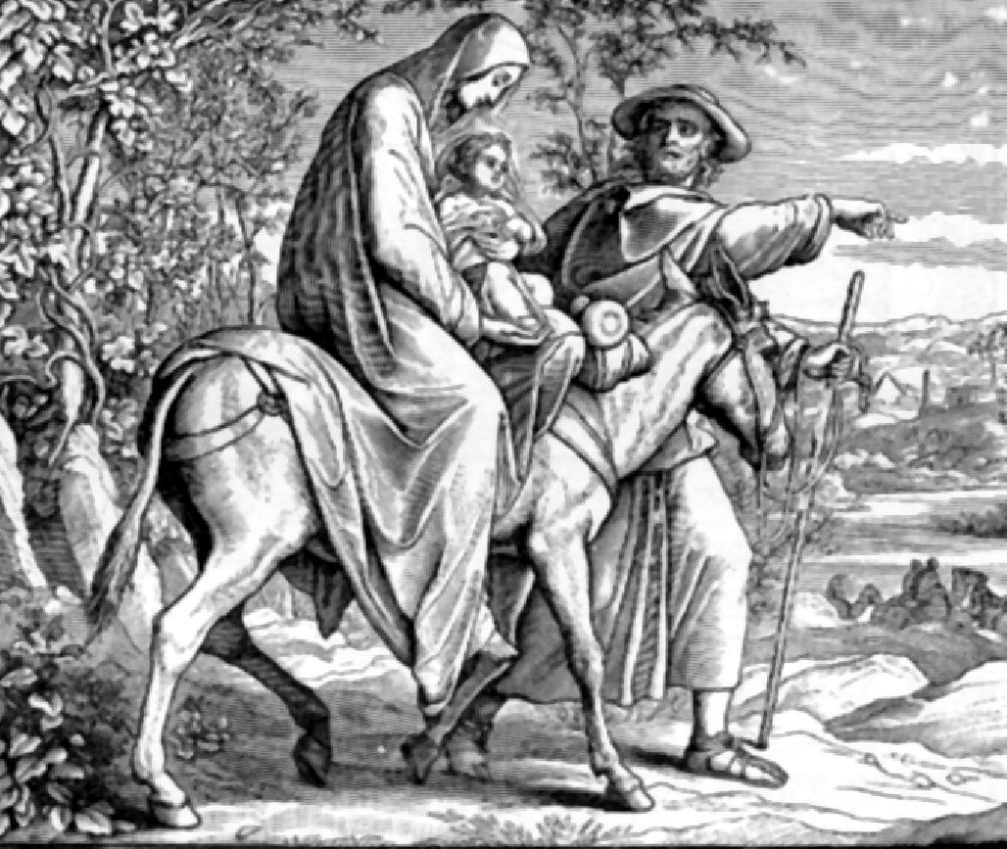
“The angel of the Lord appeareth to Joseph in a dream, saying, Arise, and take the young child and his mother and flee into Egypt.”

Slide 20
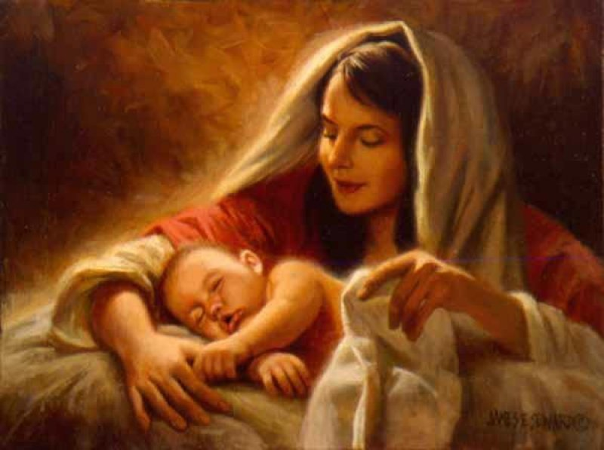
“And she brought forth a man child, who was to rule all nations with a rod of iron.”

Slide 21
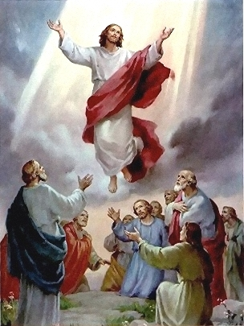
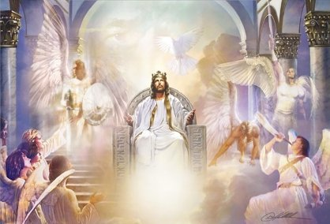
“And her child was caught up unto God, and to his throne.”

Slide 22
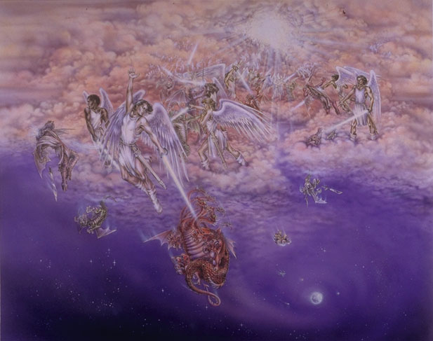
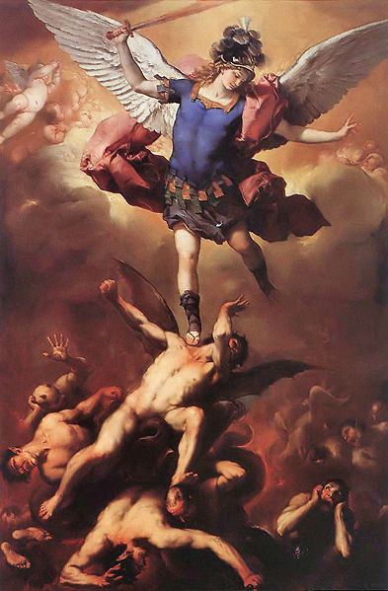
“And there was war in heaven: Michael and his angels fought against the dragon; and the dragon fought and his angels, And prevailed not; neither was their place found any more in heaven. And the great dragon was cast out, that old serpent, called the Devil, and Satan, which deceiveth the whole world: he was cast out into the earth, and his angels were cast out with him.”

Slide 23
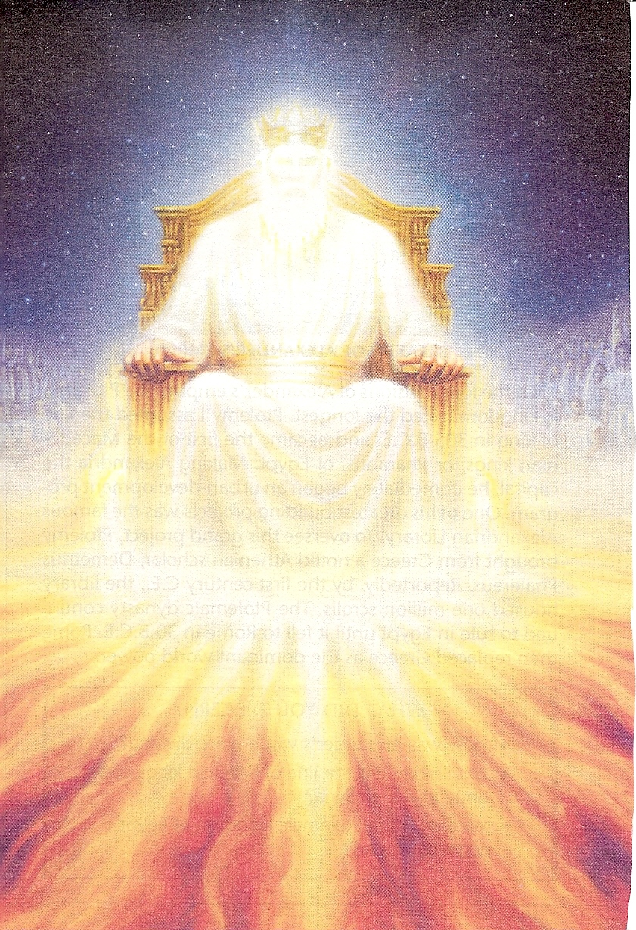
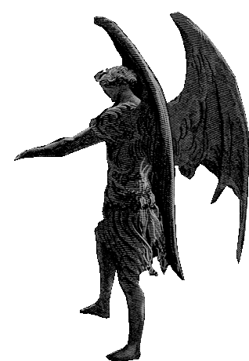
“The accuser of the brethren.”

Slide 24
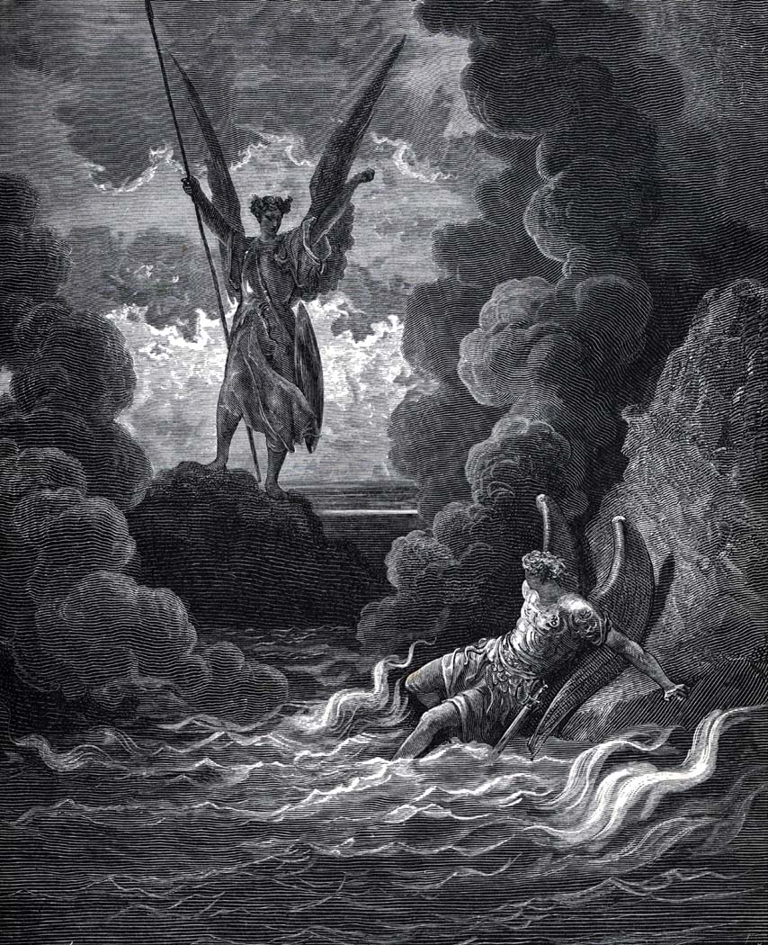
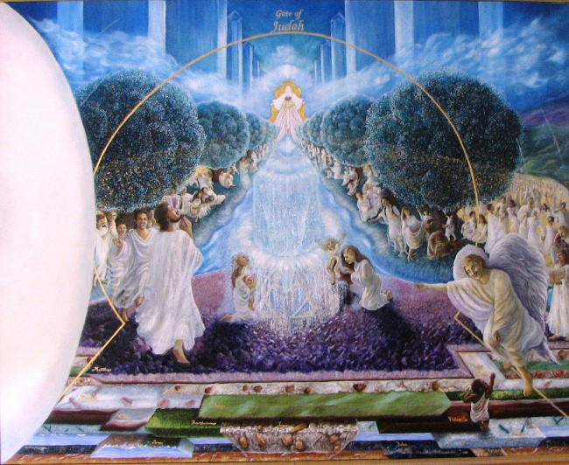
“And I heard a loud voice saying in heaven, Now is come salvation, and strength, and the kingdom of our God, and the power of his Christ: for the accuser of our brethren is cast down, which accused them before our God day and night.”

Slide 25
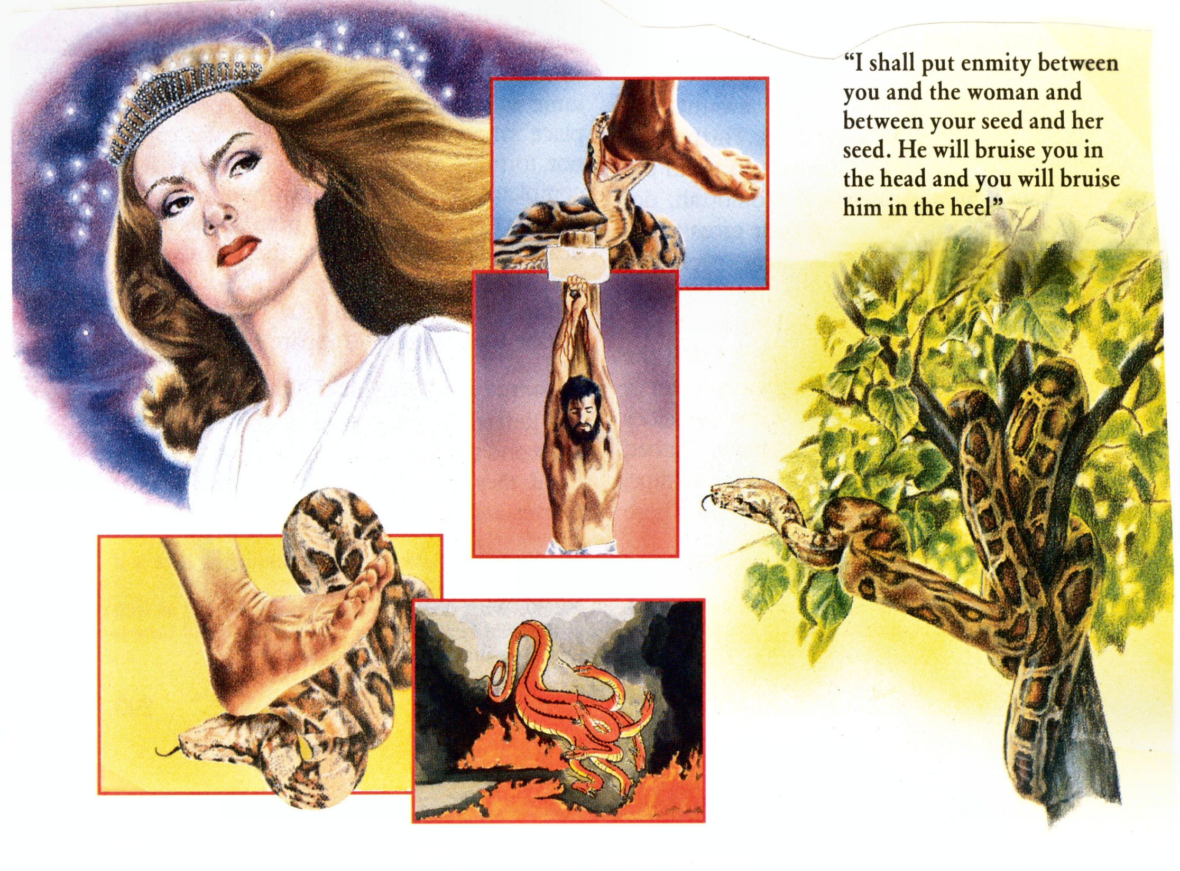
“And I will put enmity between thee and the woman, and between thy seed and her seed; it shall bruise (crush) thy head, and thou shalt bruise his heel.”

Slide 26
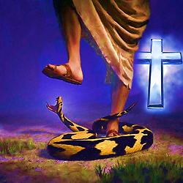
“Blotting out the handwriting of ordinances that was against us, which was contrary to us, and took it out of the way, nailing it to his cross; And having spoiled principalities and powers, he made a shew of them openly, triumphing over them in it.” (Colossians 2:14-15)

Slide 27
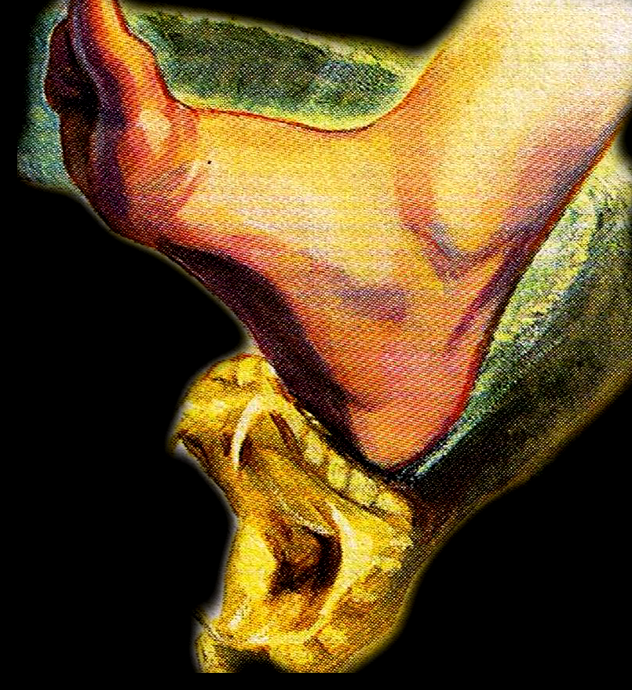
“But we see Jesus, who was made a little lower than the angels for the suffering of death, crowned with glory and honour; that he by the grace of God should taste death for every man.” (Hebrews 2:9)

Slide 28
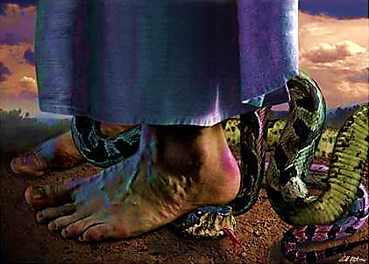
“Forasmuch then as the children are partakers of flesh and blood, he also himself likewise took part of the same; that through death he might destroy him that had the power of death, that is, the devil; And deliver them who through fear of death were all their lifetime subject to bondage.” (Hebrews 2:14-15)

Slide 29
“For though we walk in the flesh, we do not war after the flesh: For the weapons of our warfare are not carnal, but mighty through God to the pulling down of strongholds.” (II Corinthians 10:3-4)

Slide 30
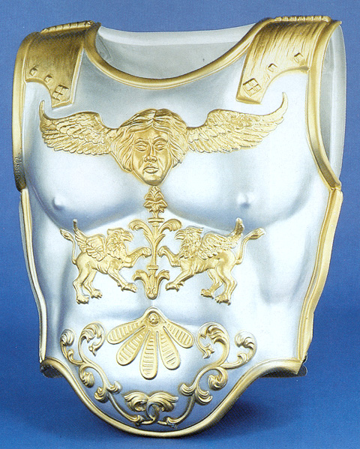
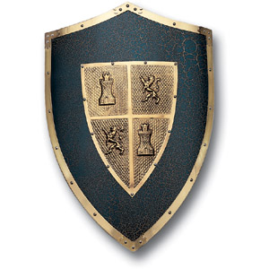
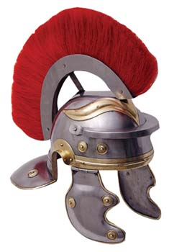
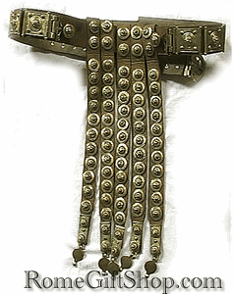
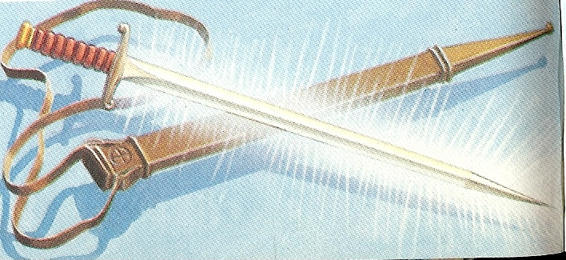
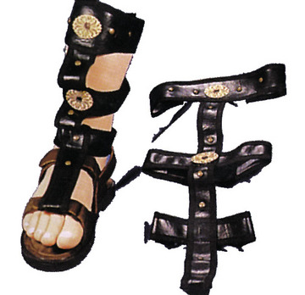

Slide 31
Victory over Satan “Resist the Devil, and he will flee from you.” (James 4:7)
He has armies, but we have mightier weapons - Isaiah 24:21
He has doctrines, but we have the Word of God – I Timothy 4:1
He has a kingdom, but he is not our king – Luke 4:6
He is the god of this age, but he is not our god – II Corinthians 4:4
He is a liar, but we have the truth – John 4:44
He is a tempter, but we can resist him – I Thessalonians 3:5

Slide 32
He is a deceiver, but we will not be deceived – Revelation 20:10
He is a destroyer, but he can not destroy us – Revelation 9:11
He perverts the Word of God, but he can not pervert our Bibles (KJV) – Matthew 4:6
He resists us in prayer, but we will pray any way – Daniel 10:12
He blinds men from the truth, but we will not be blinded by him – II Corinthians 4:4
He lays snares for men, but can discern them and avoid them – II Timothy 2:26

Slide 33
He steals the Word of God from human hearts, but he will not steal it from our hearts – Matthew 13:19
He hinders the work of God’s servants, but we will not quit serving our Lord – I Thessalonians 2:18
He afflicts the servants of God, but we will only become stronger through affliction – Job 2:7
He seeks to discourage us, but we will encourage ourselves in the Lord – I Samuel 30:6
He desires to gain strongholds in our lives, but we will not give place to him – Ephesians 4:27
He seeks to divide us, but we will not be divided – Proverbs 6:14

Slide 34
“Ye are of God, little children, and have overcome them: because greater is he that is in you, than he that is in the world.” (I John 4:4)

Slide 35
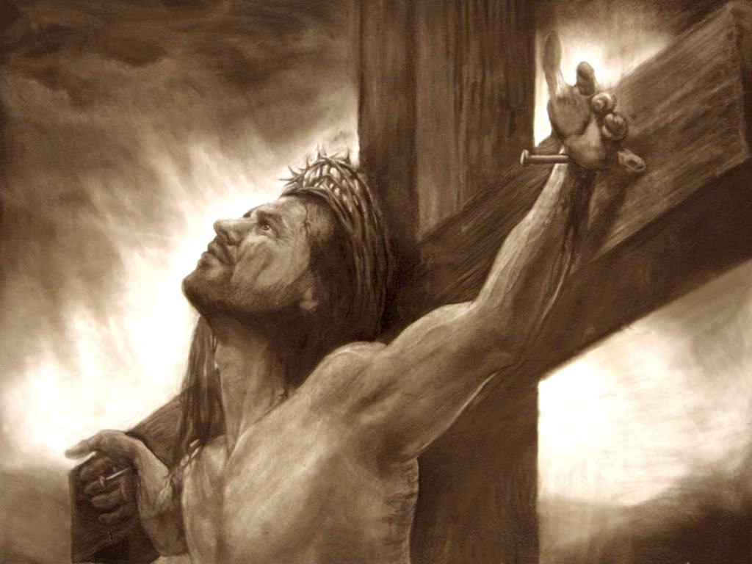
“And they overcame him by the blood of the Lamb, and by the word of their testimony; and they loved not their lives unto the death.” (Revelation 12:11)

Slide 36
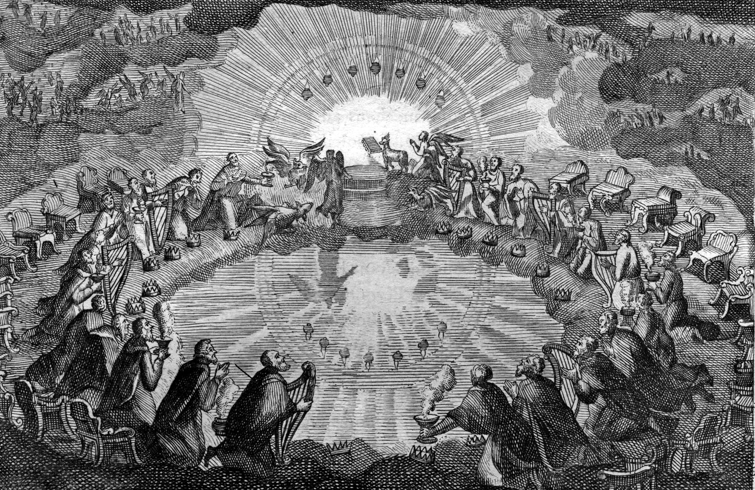
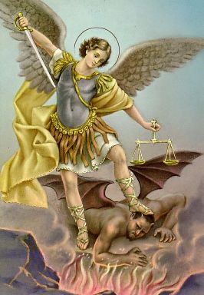
“Therefore rejoice, ye heavens, and ye that dwell in them…”

Slide 37
“Woe to the inhabiters of the earth and of the sea! for the devil is come down unto you, having great wrath, because he knoweth that he hath but a
short time.”

Slide 38
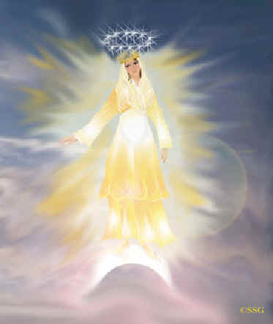
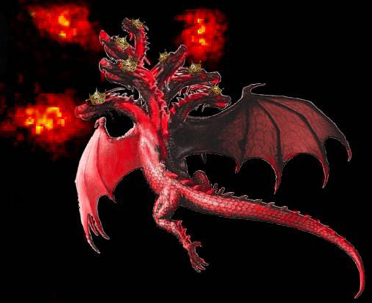
“And when the dragon saw that he was cast unto the earth, he persecuted the woman which brought forth the man child.”

Slide 39
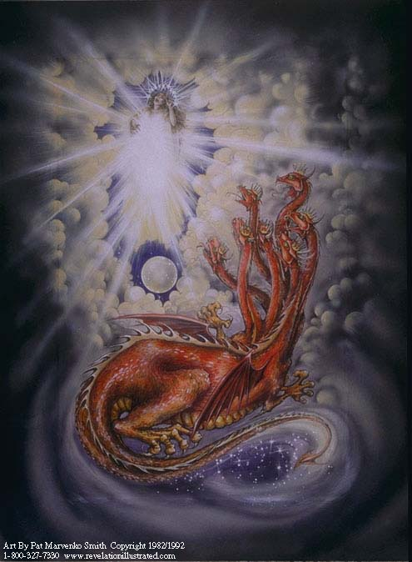
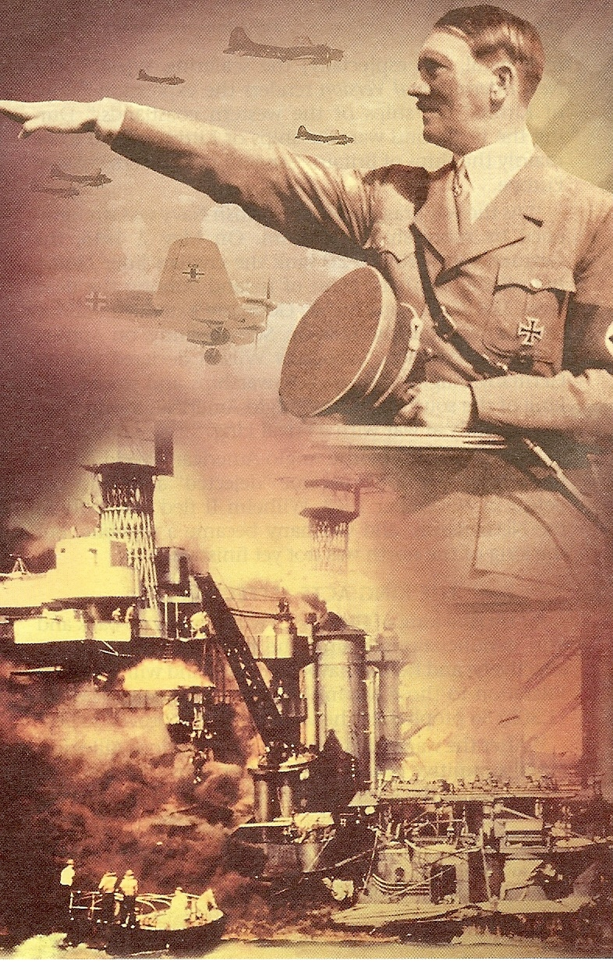
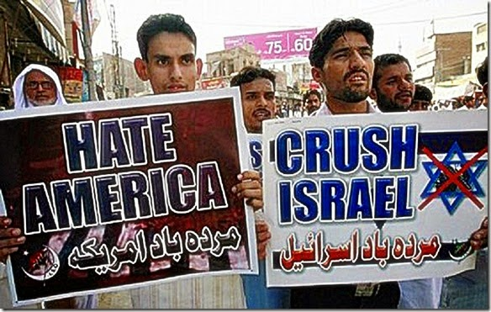

Slide 40
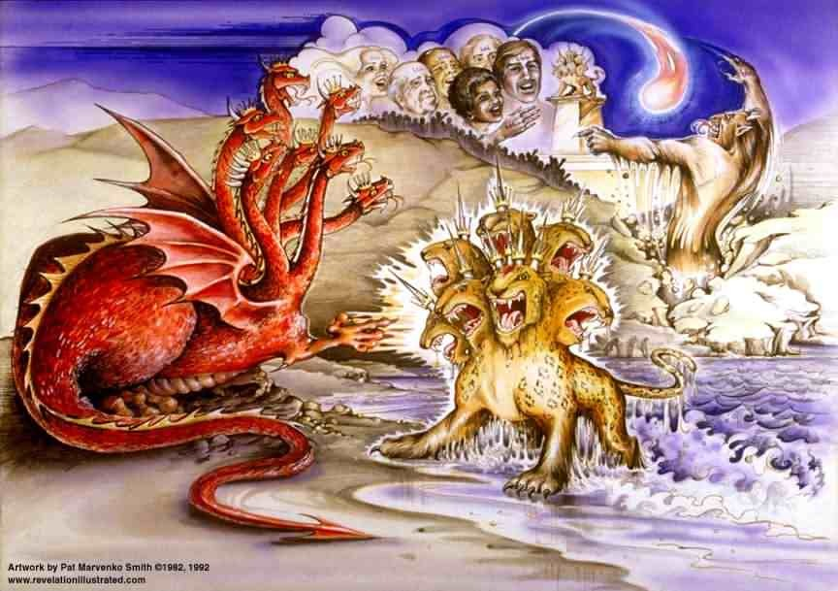

Slide 41
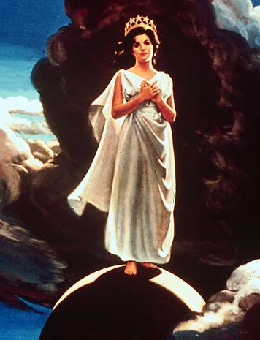
“And the woman fled into the wilderness, where she hath a place prepared of God, that they should feed her there a thousand two hundred and threescore days (3 ½ years)…And to the woman were given two wings of a great eagle…”

Slide 42
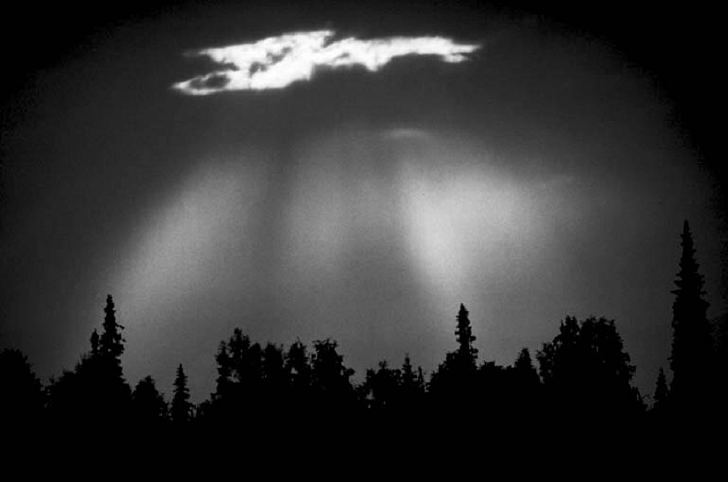
“…that she might fly into the wilderness, into her place…”

Slide 44
“And the serpent cast out of his mouth water as a flood after the woman, that he might cause her to be carried away of the flood. And the earth helped the woman, and the earth opened her mouth, and swallowed up the flood which the dragon cast out of his mouth.”

Slide 46
“And the dragon was wroth with the woman, and went to make war with the remnant of her seed, which keep the commandments of God, and have the testimony of Jesus Christ.”

Slide 47
“And who is he that will harm you, if ye be followers of that which is good?” I Peter 3:13
“The angel of the LORD encampeth round about them that fear him, and delivereth them.” Psalm 34:7

Slide 48
“Who shall lay any thing to the charge of God's elect? It is God that justifieth. Who is he that condemneth? It is Christ that died, yea rather, that is risen again, who is even at the right hand of God, who also maketh intercession for us. Who shall separate us from the love of Christ? shall tribulation, or distress, or persecution, or famine, or nakedness, or peril, or sword? As it is written, For thy sake we
are killed all the day long;

Slide 49
we are accounted as sheep for the slaughter. Nay, in all these things we are more than conquerors through him that loved us. For I am persuaded, that neither death, nor life, nor angels, nor principalities, nor powers, nor things present, nor things to come, Nor height, nor depth, nor any other creature, shall be able to separate us from the love of God, which is in Christ Jesus our Lord.”
(Romans 8:33-39)

Slide 50
(Isaiah 43:1) “Fear not: for I have redeemed thee, I have called thee by thy name; thou art mine.”
(Psalms 50:15) “And call upon me in the day of trouble: I will deliver thee.”
(Jeremiah 29:12) “Then shall ye call upon me, and ye shall go and pray unto me, and I will hearken unto you.”

Slide 51
“And I give unto them eternal life; and they shall never perish, neither shall any man pluck them out of my hand.
My Father, which gave them me, is greater than all; and no man is able to pluck them out of my Father's hand.”
(John 10:28-29)

