Slide 1
The Revelation of Jesus Christ
A study of the book
of Revelation

Slide 2
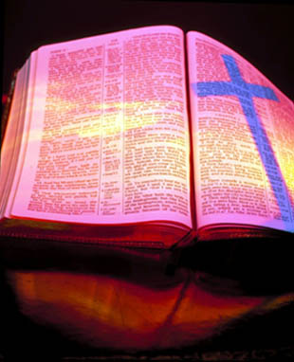
Revelation 8:1-11:19
“The Seven Trumpets”

Slide 3
Revelation 6:1-17
“The Seven Seal Judgments”

Slide 4
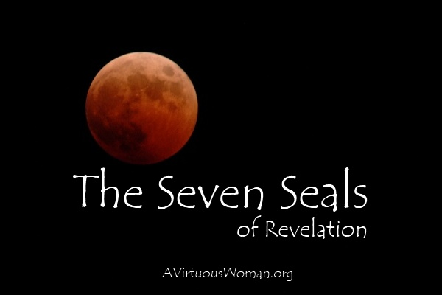

Slide 5
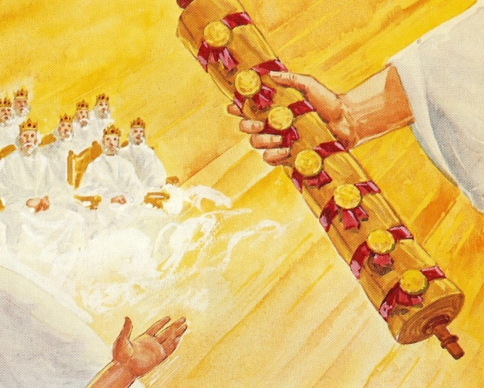
6:1-8

Slide 6
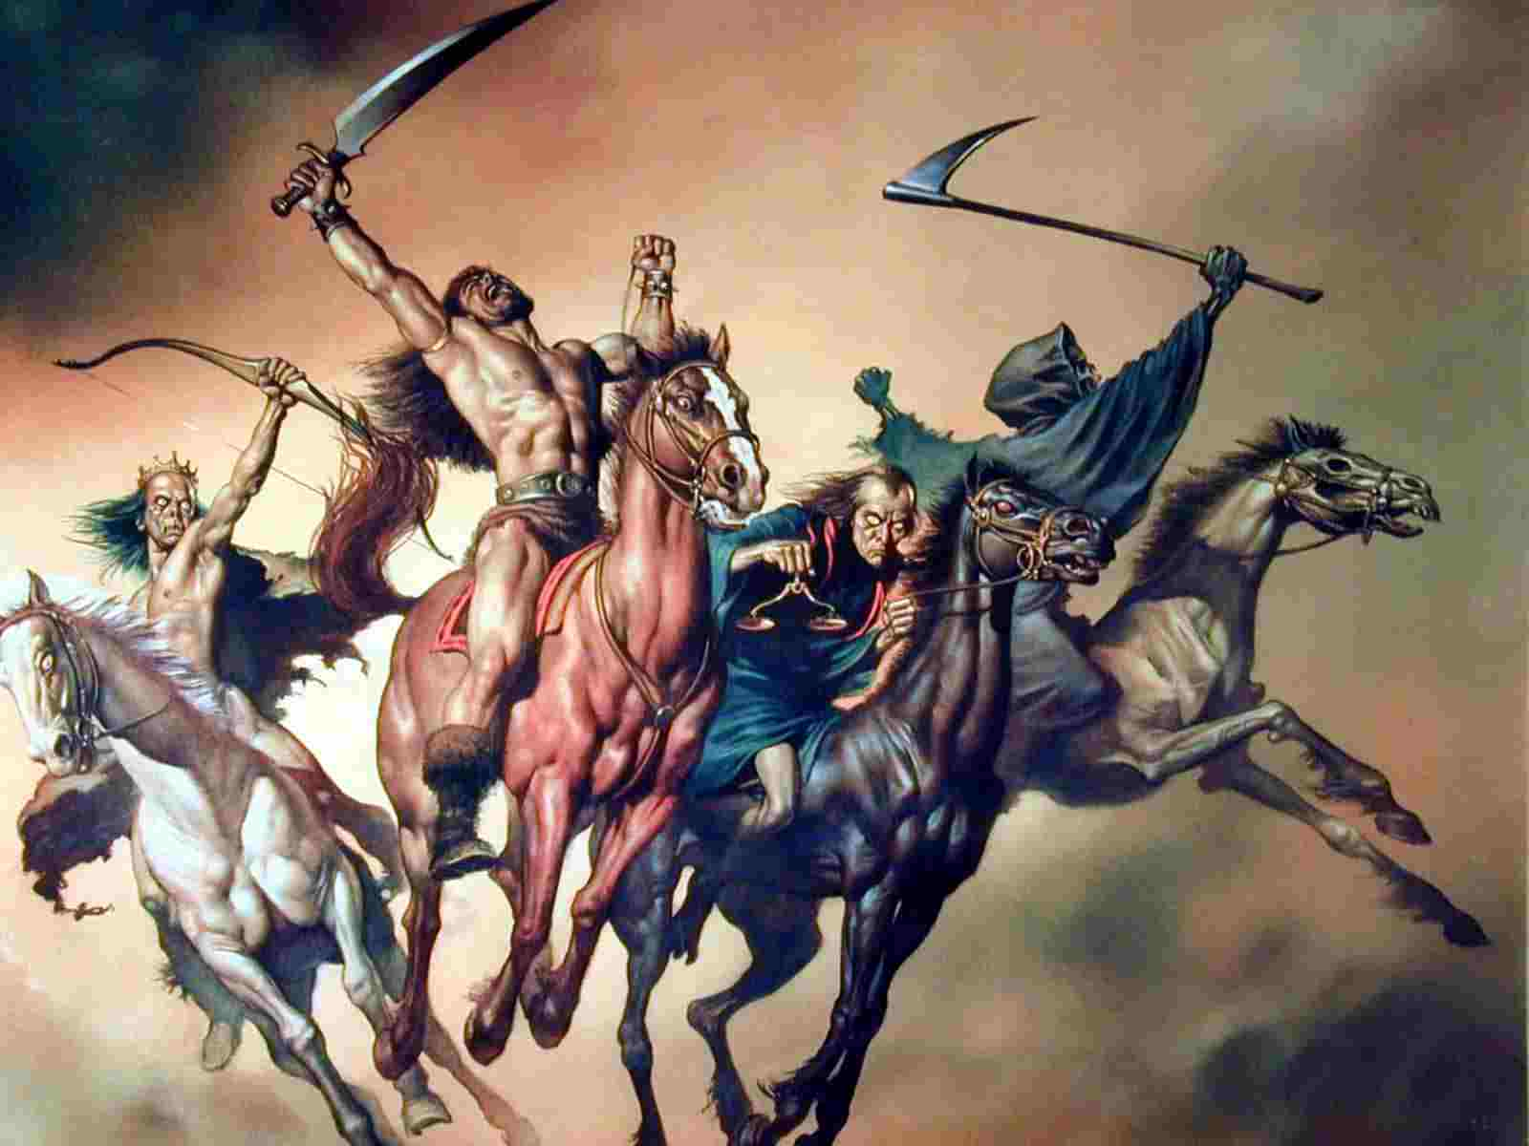

Slide 7
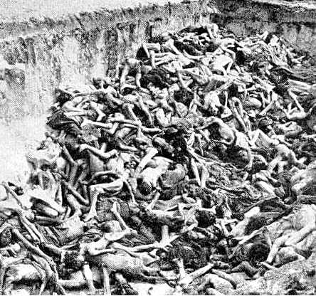
World’s present population 7 billion ¼ of the world’s population = 1.75 billion

Slide 8
6:9-11

Slide 9
6:12-17

Slide 10
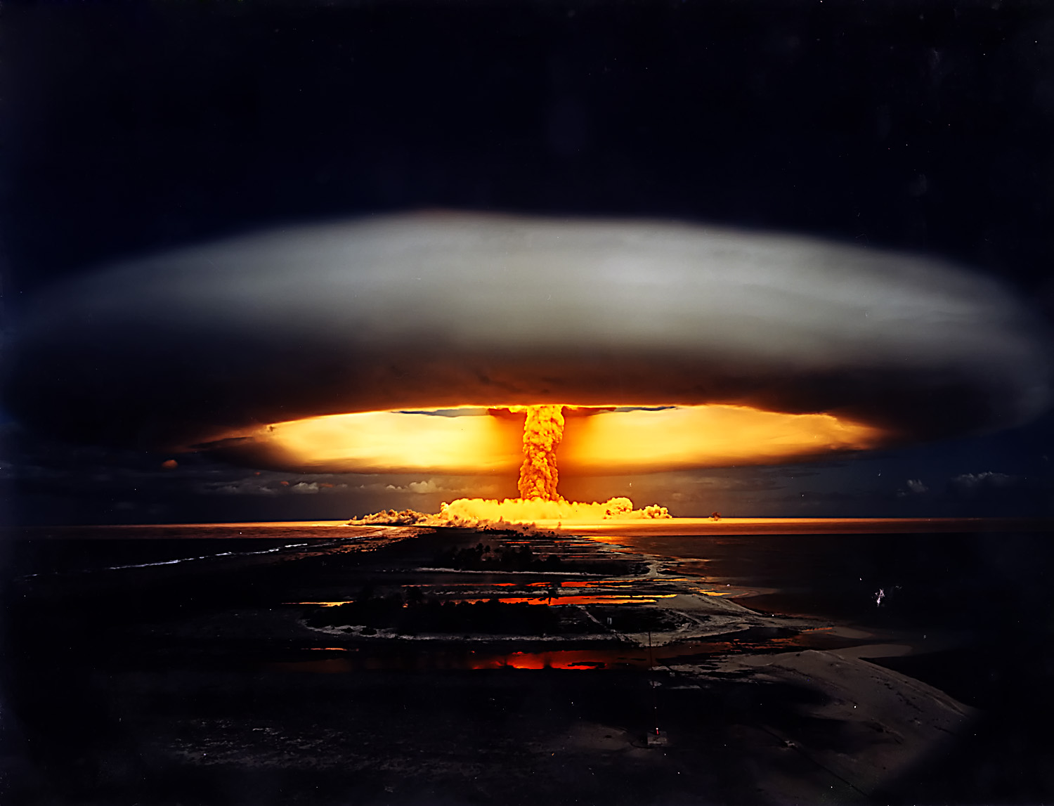
“And I beheld when he had opened the sixth seal, and, lo, there was a great earthquake; and the sun became black as sackcloth of hair, and the moon became as blood; And the stars of heaven fell unto the earth, even as a fig tree casteth her untimely figs, when she is shaken of a mighty wind. And the heaven departed as a scroll when it is rolled together; and every mountain and island were moved out of their places.”

Slide 11
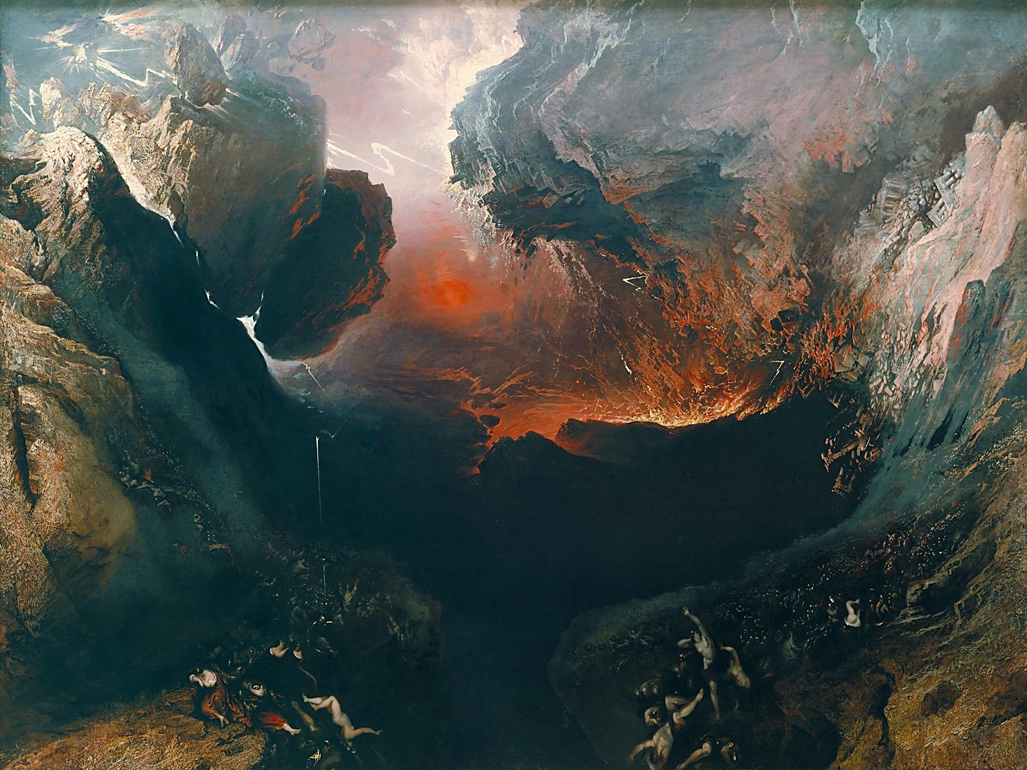
“And the kings of the earth, and the great men, and the rich men, and the chief captains, and the mighty men, and every bondman, and every free man, hid themselves in the dens and in the rocks of the mountains; And said to the mountains and rocks, Fall on us…”

Slide 12
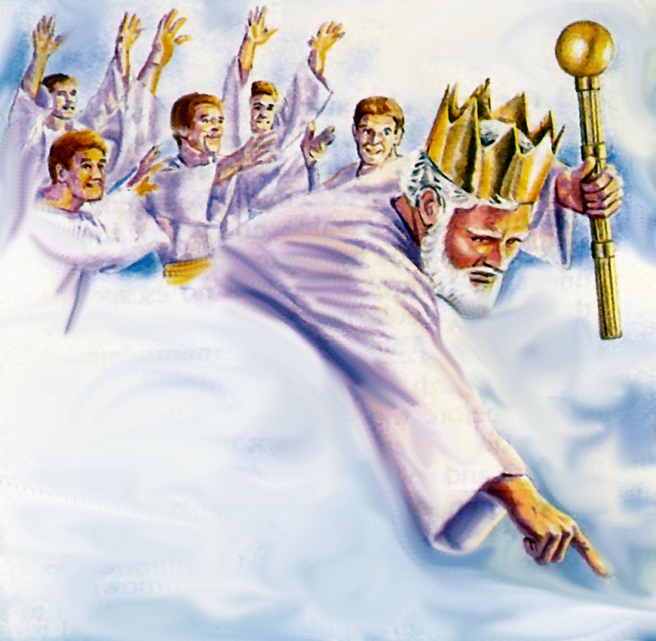
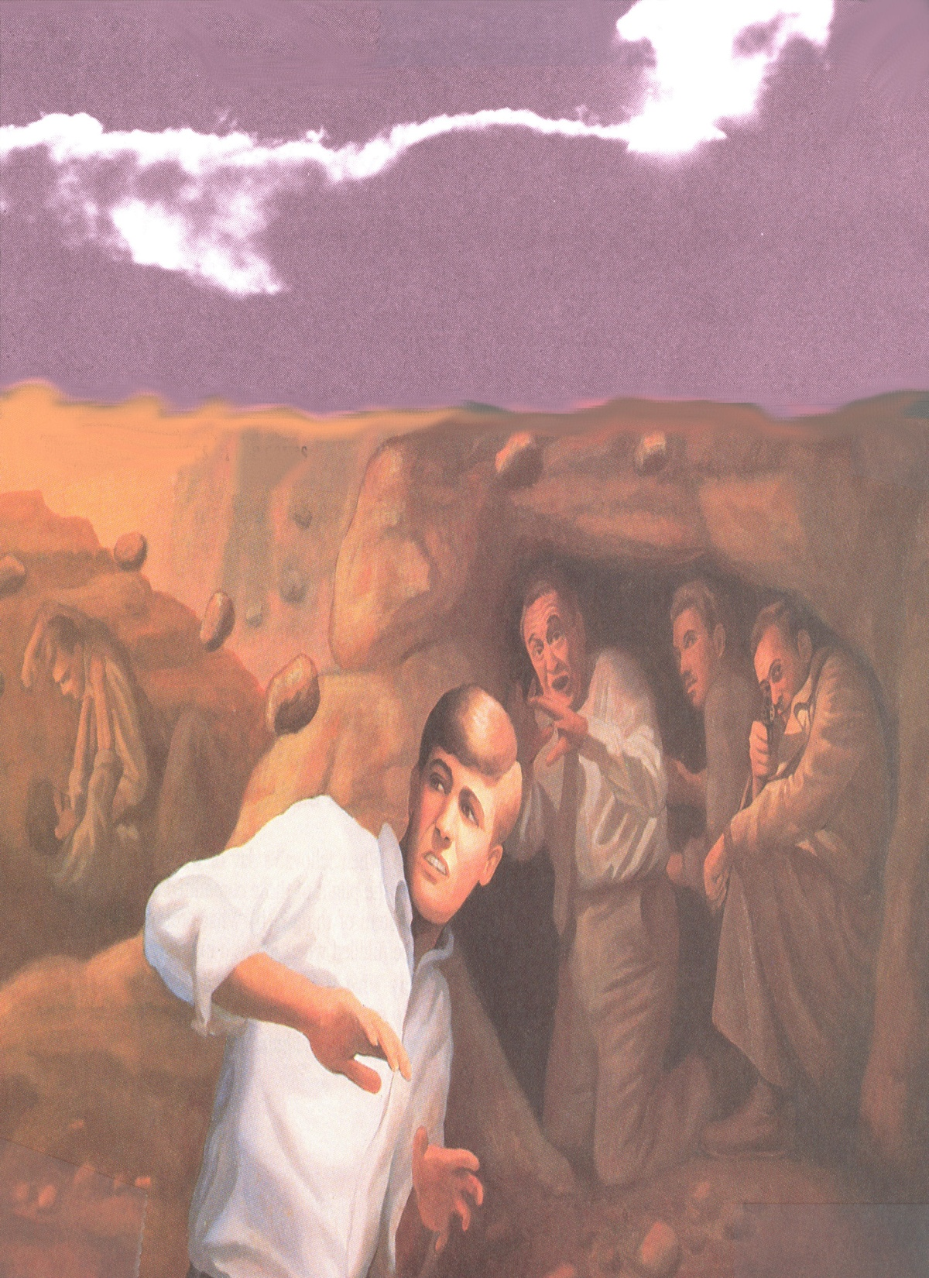
“Hide us from the face of Him that sitteth on the throne, and from the wrath of the Lamb. For the great day of His wrath is come; and who shall be able to stand.”

Slide 13
Revelation 8:1-11:19
“The Seven Trumpets”

Slide 14
Seven Seal Judgments (Revelation 8:1-5)

Slide 15
“And when he had opened the seventh seal, there was silence in heaven about the space of half an hour. And I saw the seven angels which stood before God; and to them were given seven trumpets.”

Slide 16
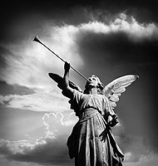
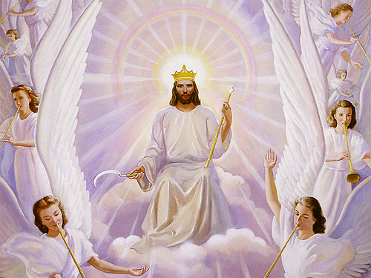

Slide 17
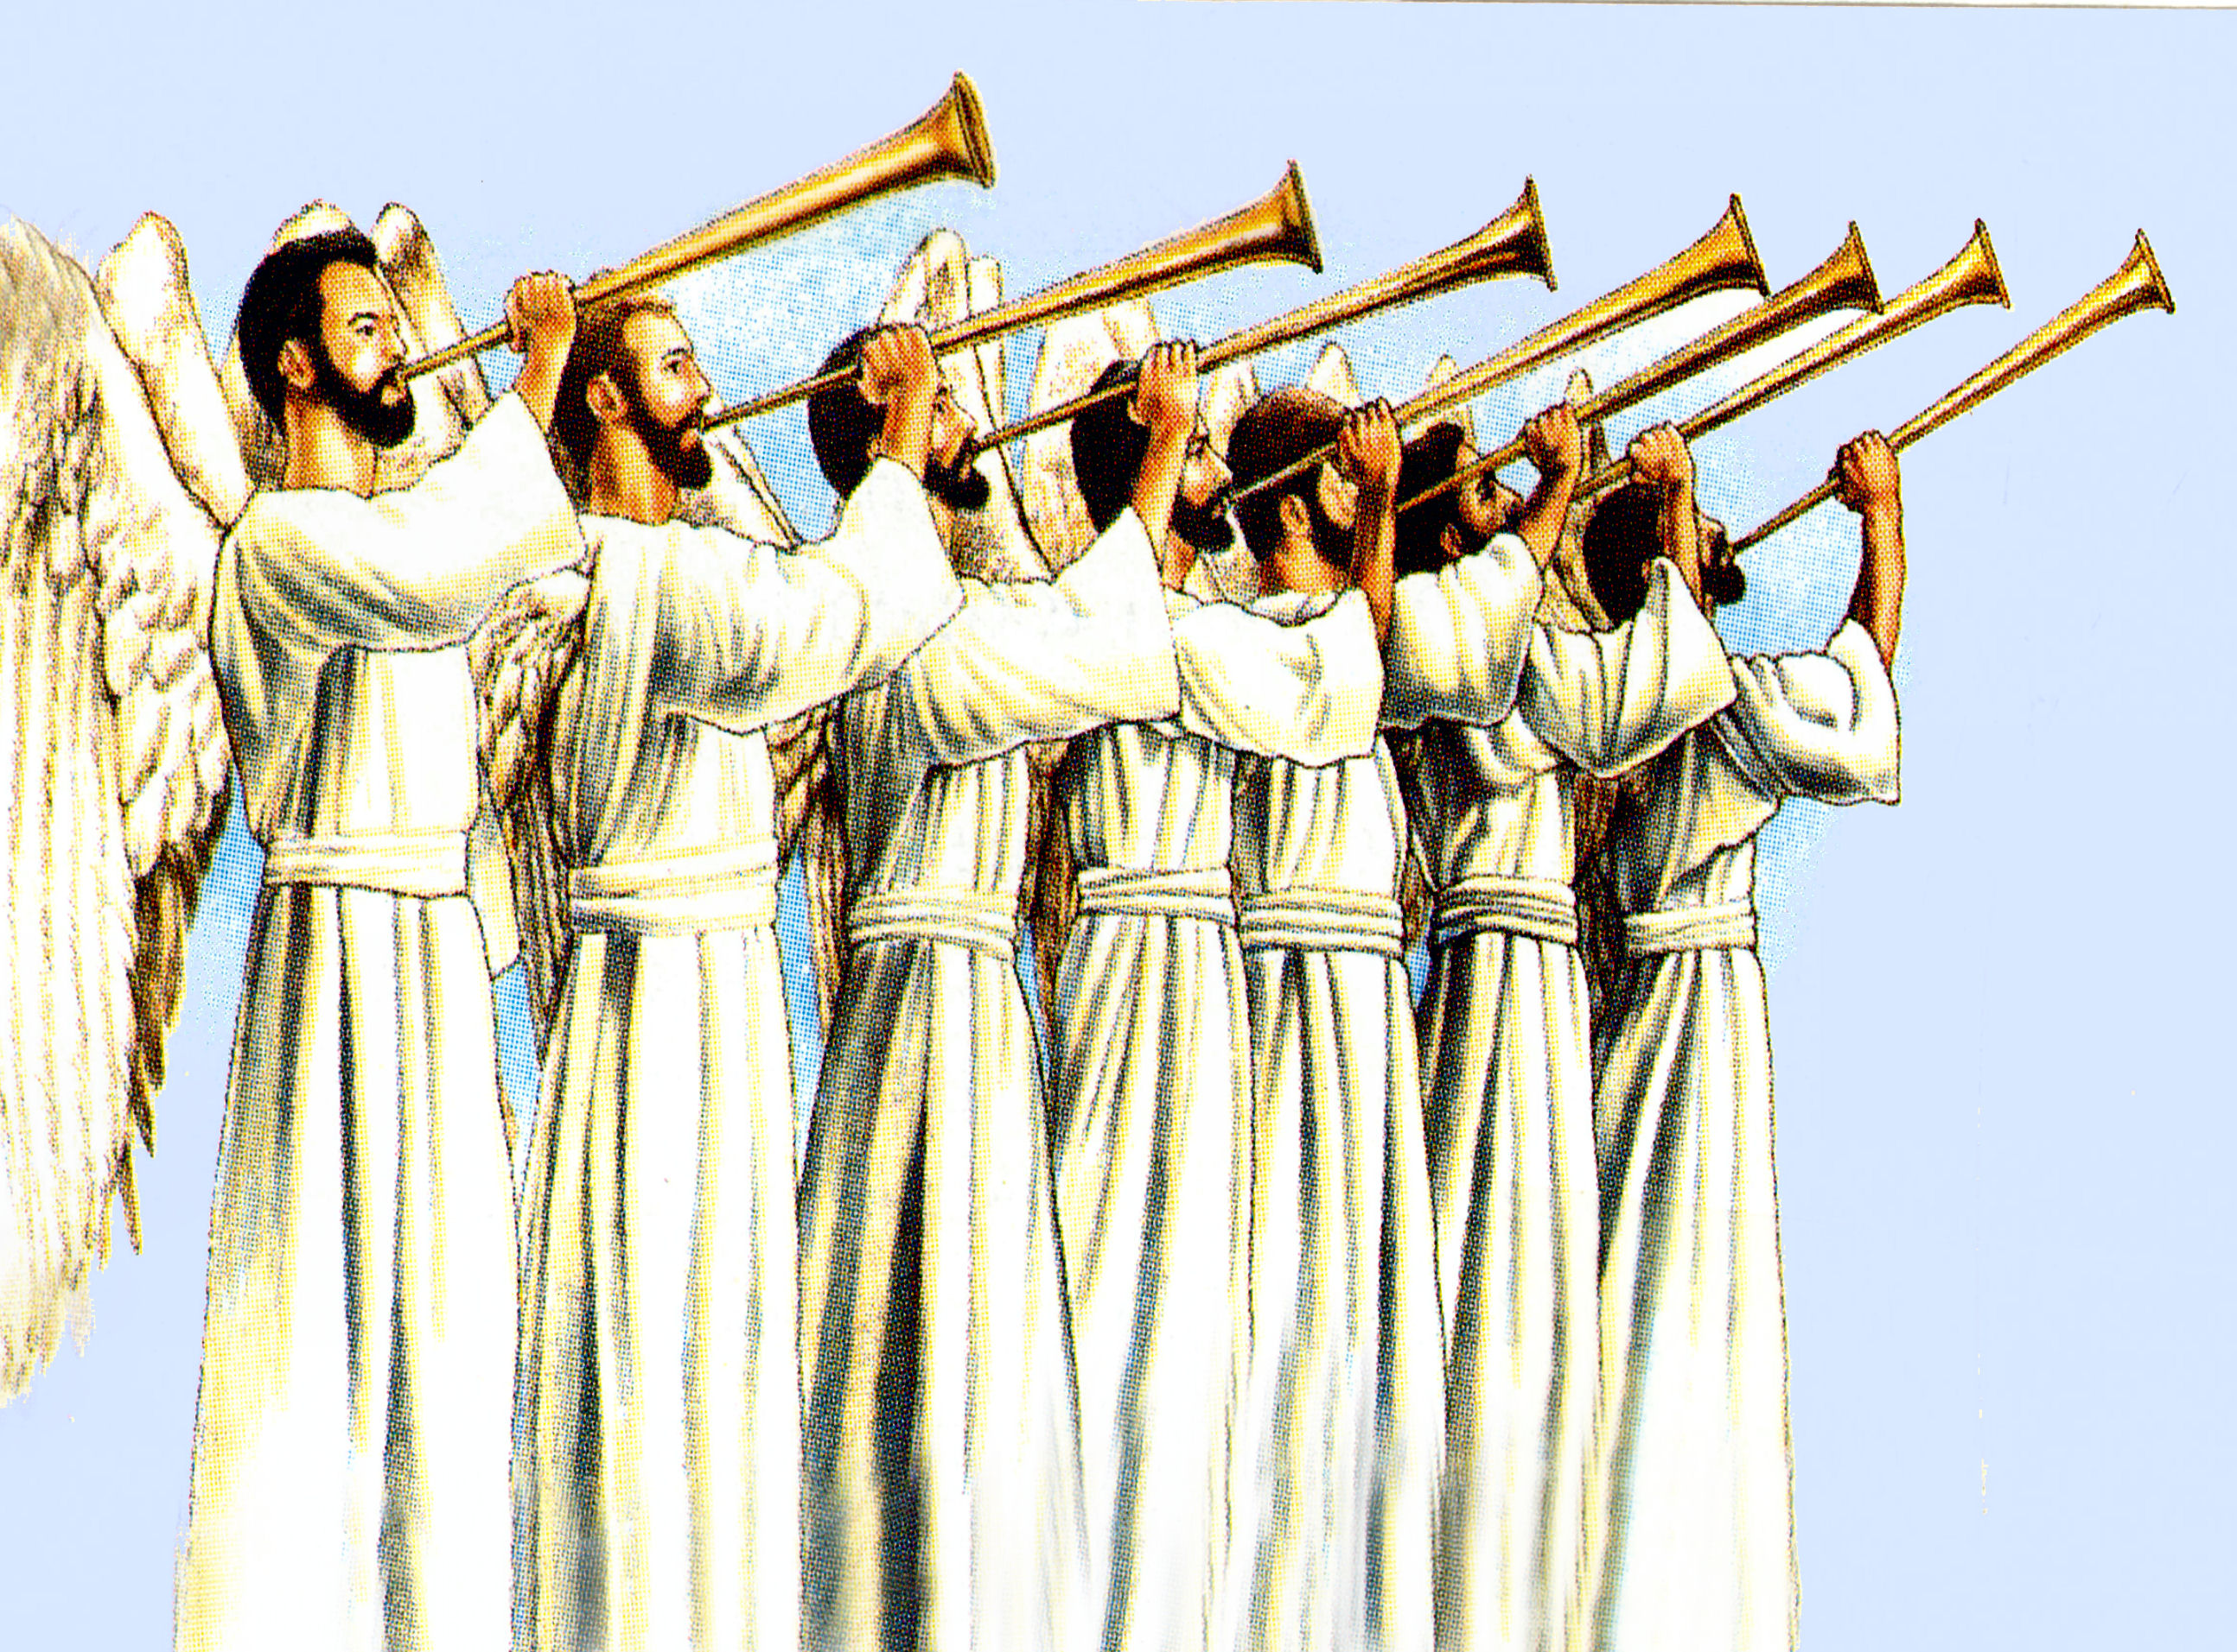

Slide 18
“And another angel came and stood at the altar, having a golden censer; and there was given unto him much incense, that he should offer it with the prayers of all saints upon the golden altar which was before the throne. And the smoke of the incense, which came with the prayers of the saints, ascended up before God out of the angel's hand.”

Slide 19
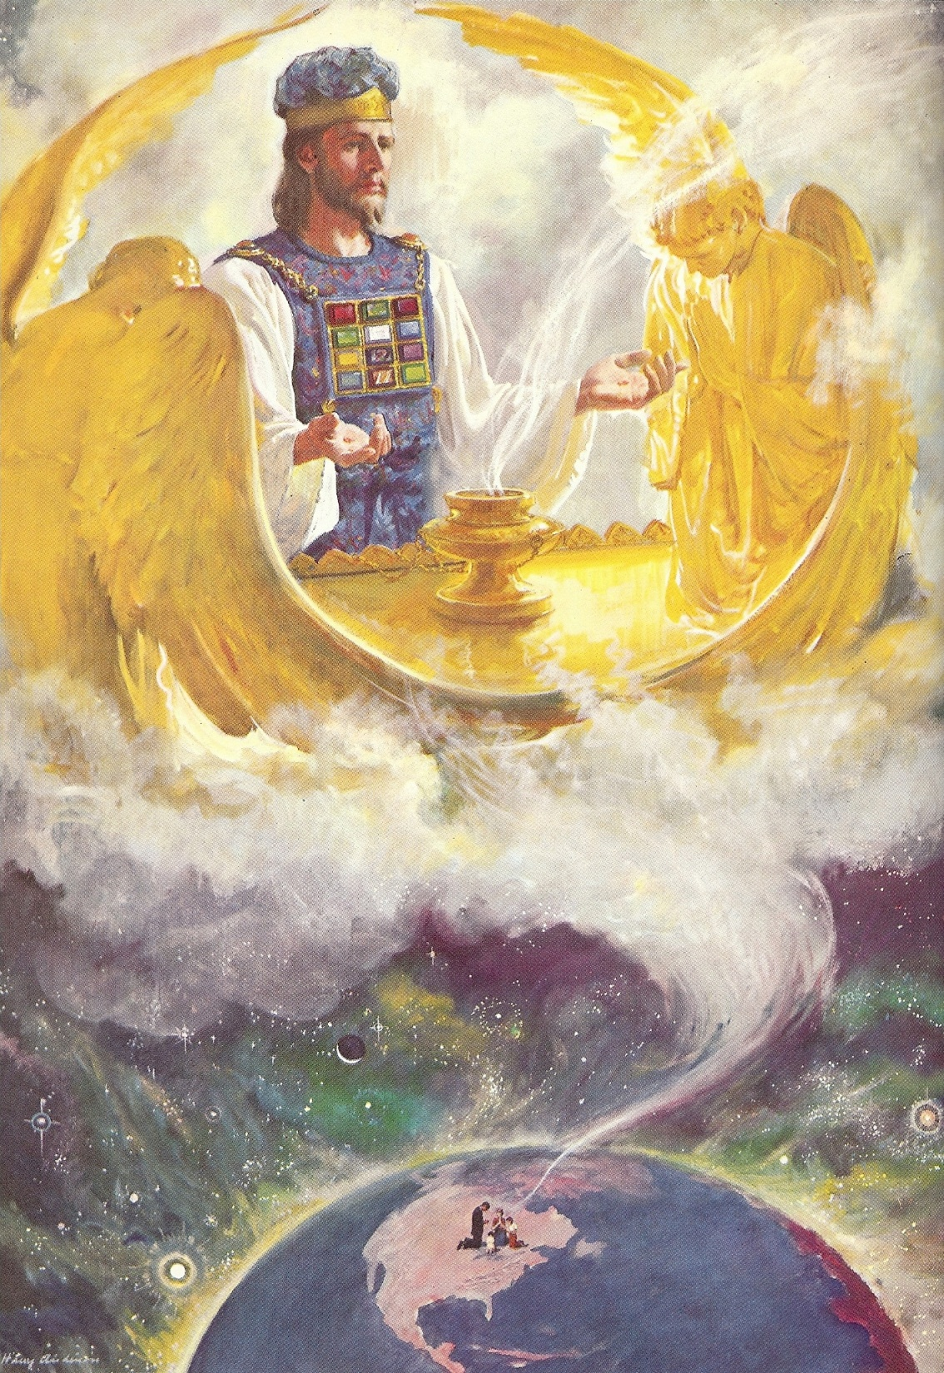
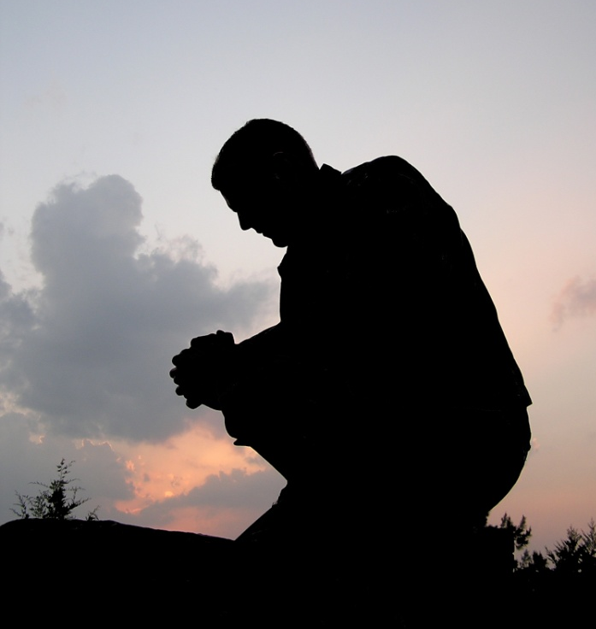
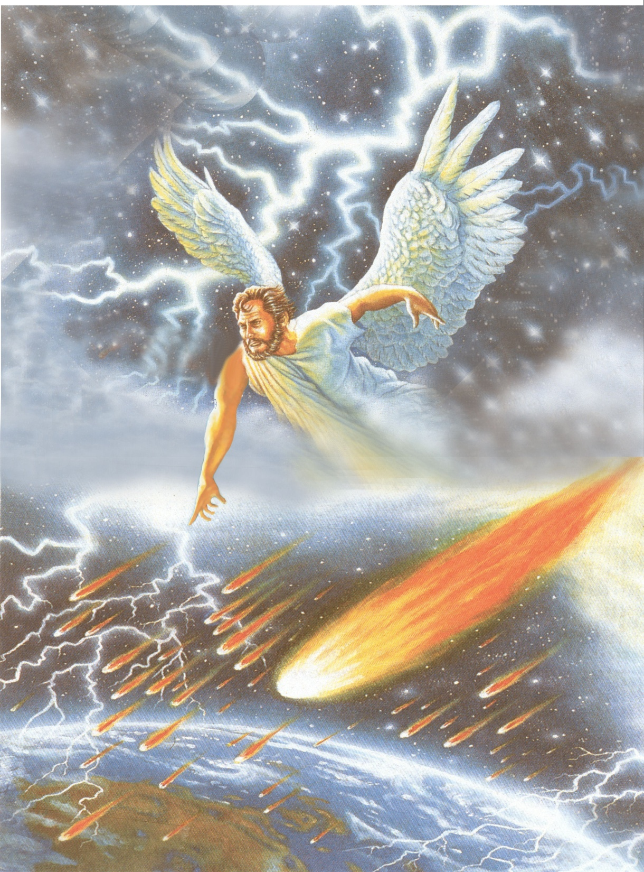

Slide 20
“And the angel took the censer, and filled it with fire of the altar, and cast it into the earth”
Censer will be filled with fire - (judgment)
Cast into the earth
Voices (noises)
Thunder
Lighting
Earthquake

Slide 21
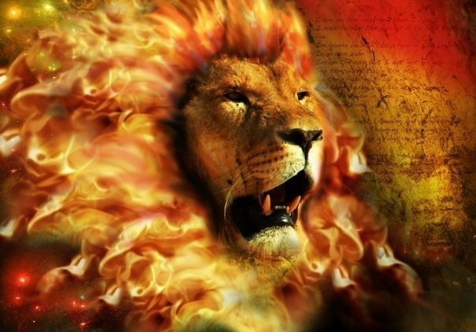
“For the Wrath of God is revealed from heaven against all ungodliness and unrighteousness of men, who hold the truth in unrighteousness.” (Romans 1:18)

Slide 22
“And the seven angels which had the seven trumpets prepared themselves to sound.”

Slide 23
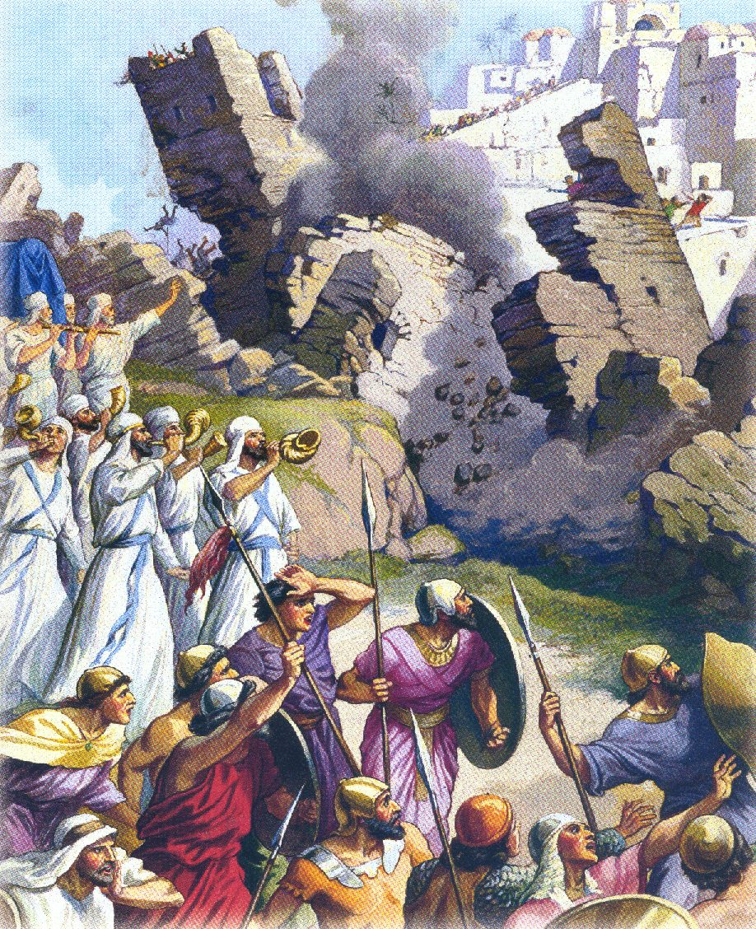
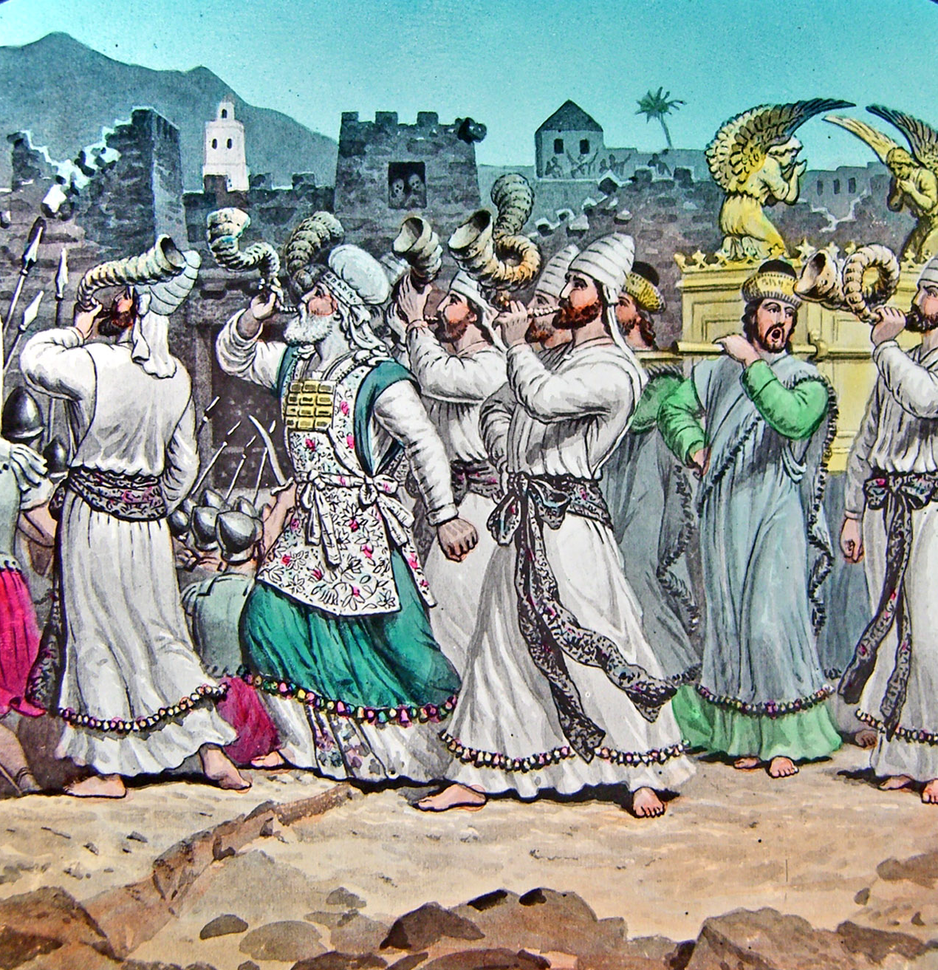

Slide 24
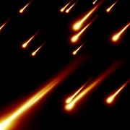
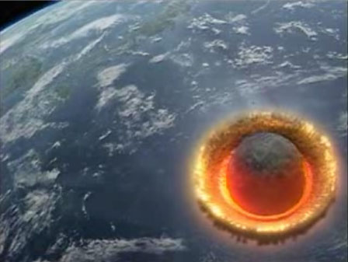
“The first angel sounded, and there followed hail and fire mingled with blood, and they were cast upon the earth: and the third part of trees was burnt up, and all green grass was burnt up.”

Slide 25
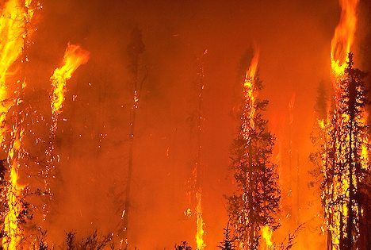
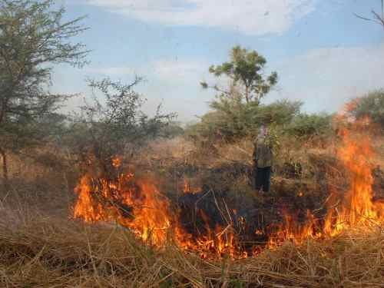
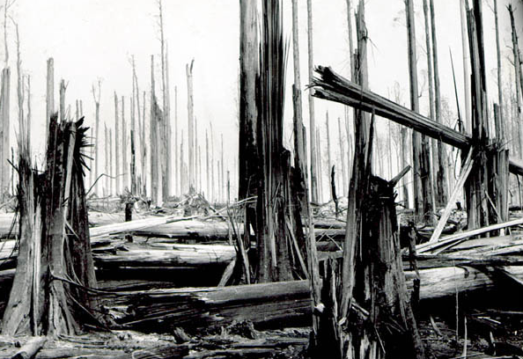
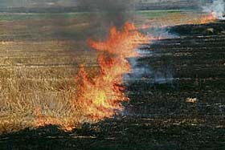
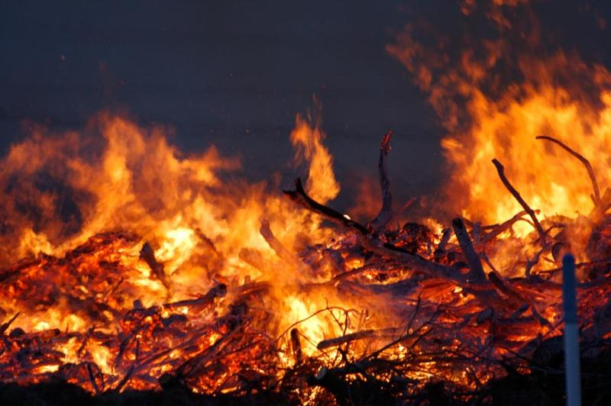

Slide 26
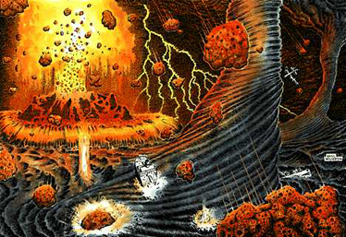
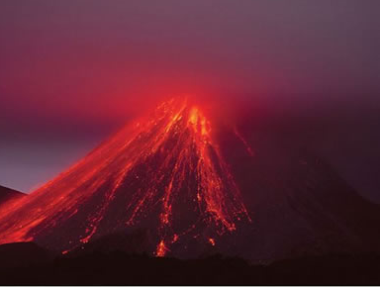
“And the second angel sounded, and as it were a great mountain burning with fire was cast into the sea.”

Slide 27
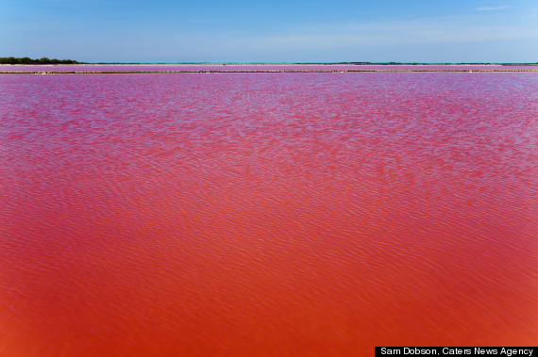
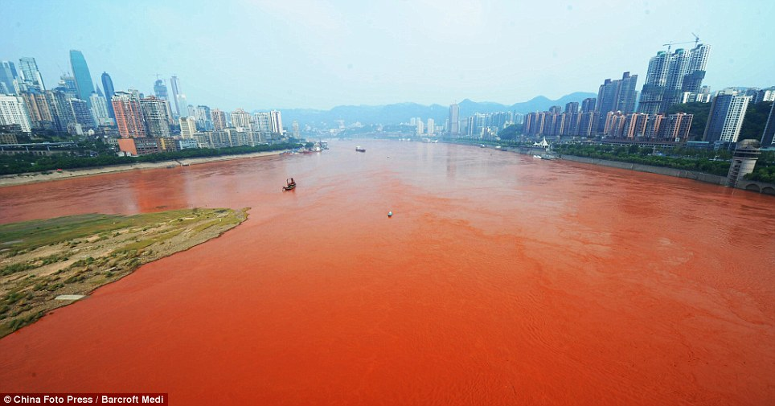
“And the third part of the sea became blood…”

Slide 28
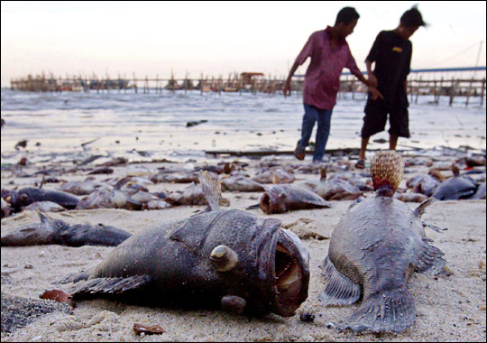
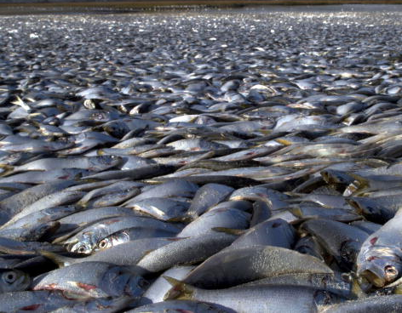
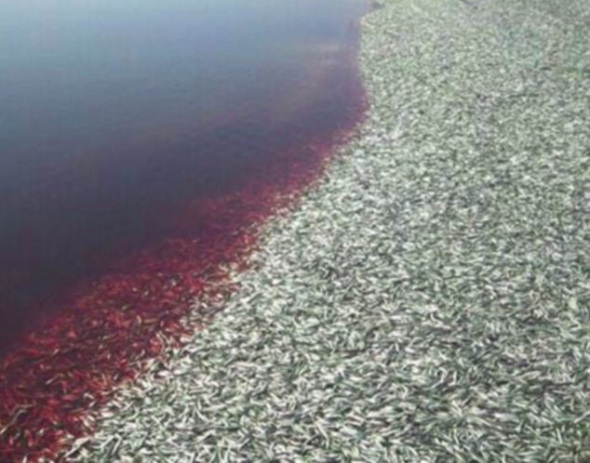
“And the third part of the creatures which were in the sea, and had life, died…”

Slide 29
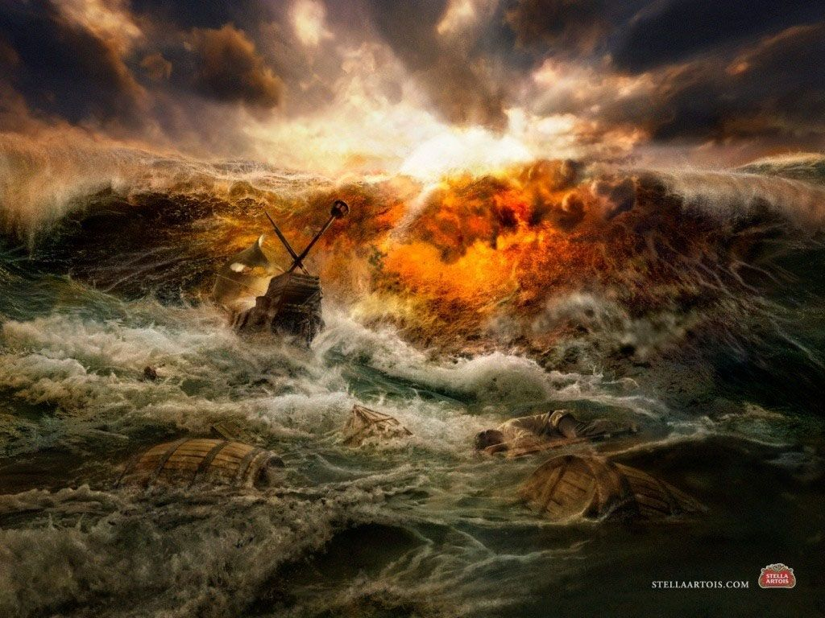
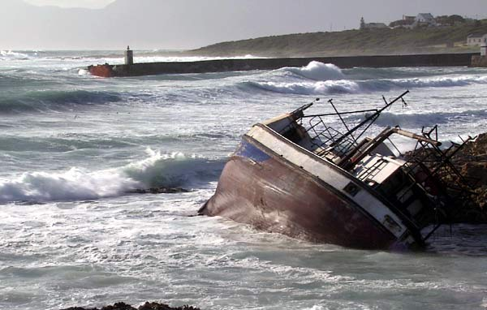
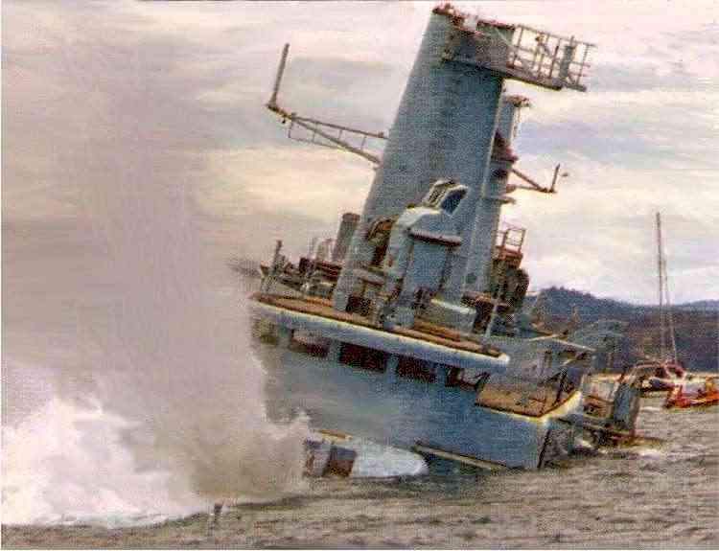
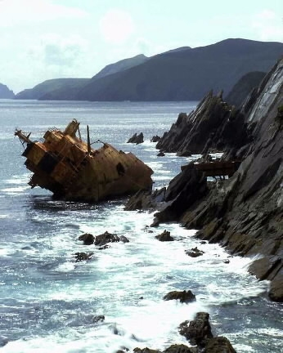
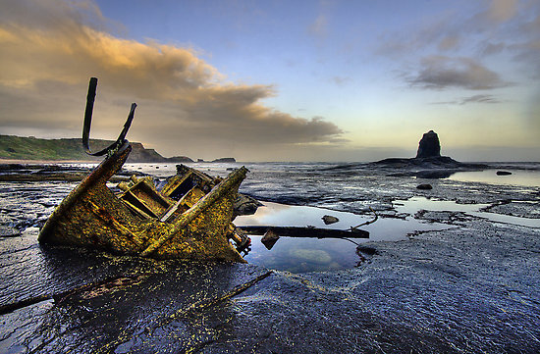
“And the third part of the ships were destroyed.”

Slide 30
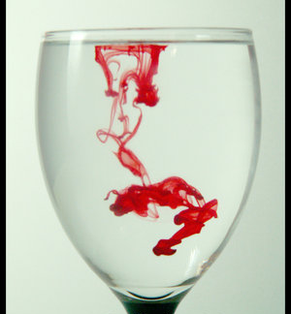
“The same shall drink of the wine of the wrath of God, which is poured out without mixture into the cup of His indignation.” (Revelation 14:10)

Slide 31
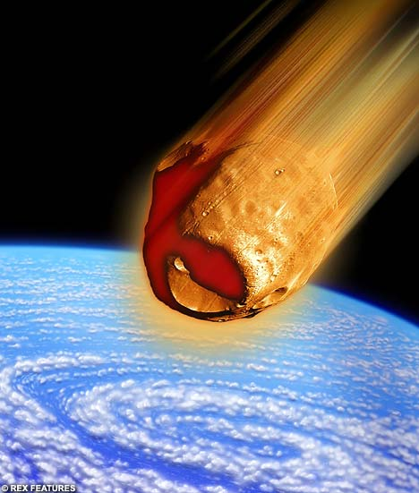
“And the third angel sounded, and there fell a great star from heaven, burning as it were a lamp, and it fell upon the third part of the rivers, and upon the fountains of waters.”

Slide 32
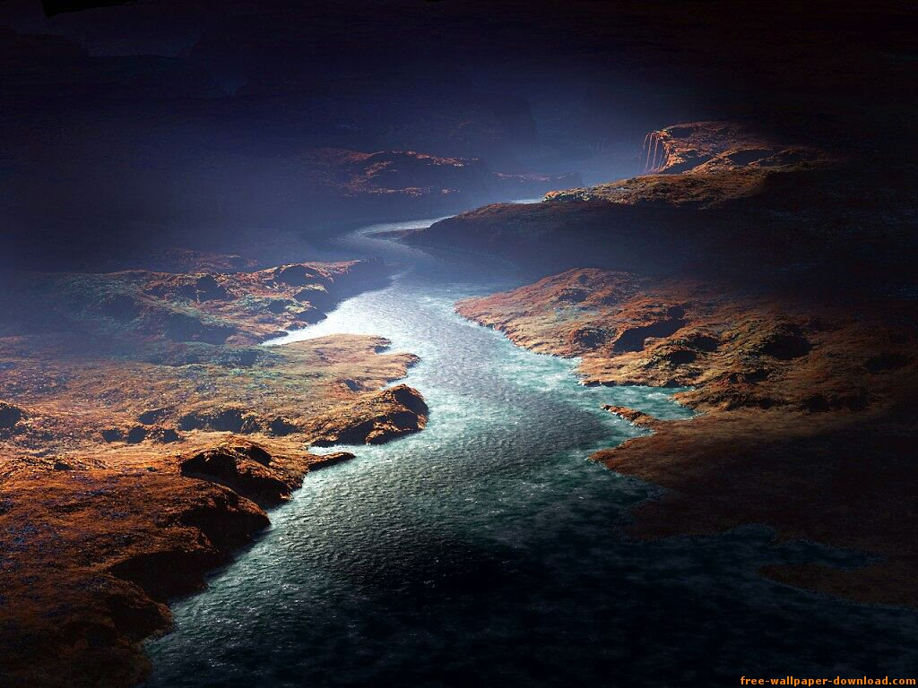
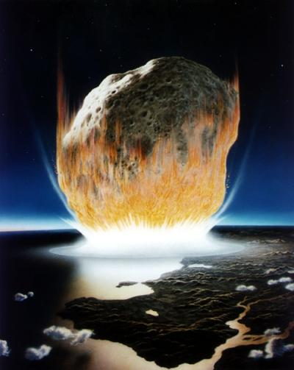
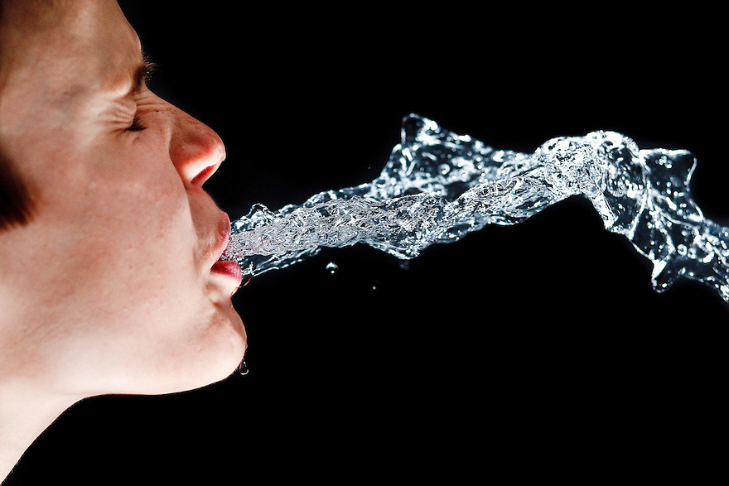
Wormwood

Slide 33
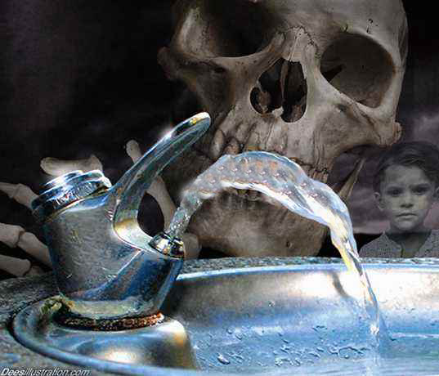
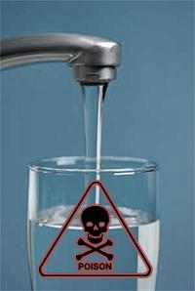
“And the name of the star is called Wormwood: and the third part of the waters became wormwood.”

Slide 34
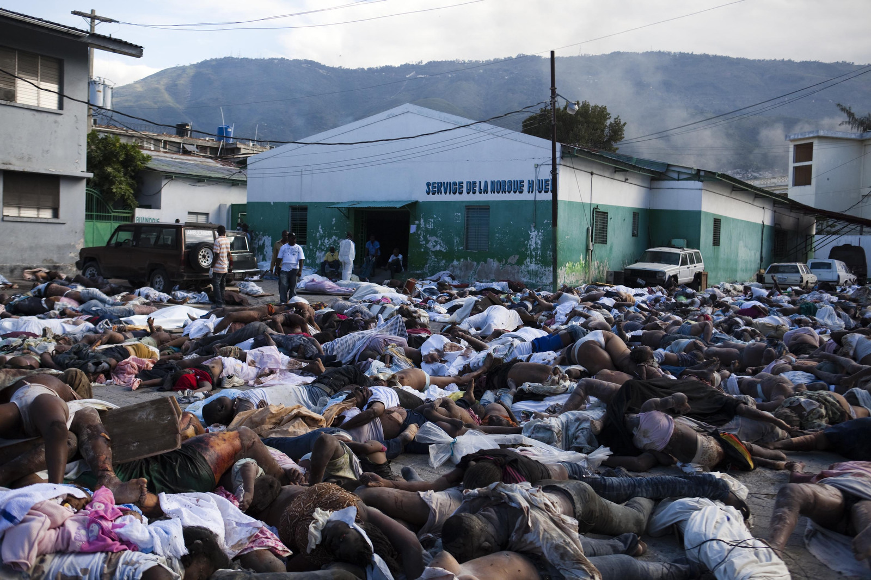
“And many men died of the waters, because they were made bitter.”

Slide 35
“And the fourth angel sounded, and the third part of the sun was smitten, and the third part of the moon, and the third part of the stars; so as the third part of them was darkened, and the day shone not for a third part of it, and the night likewise.”

Slide 36
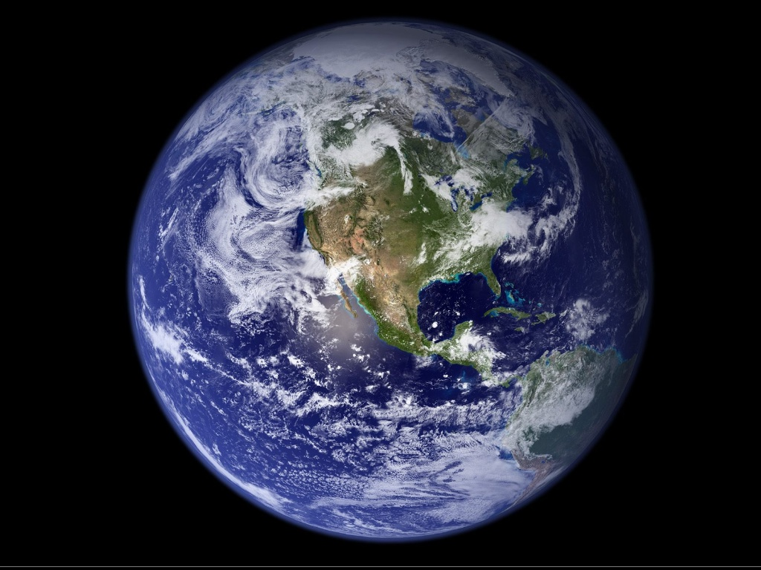
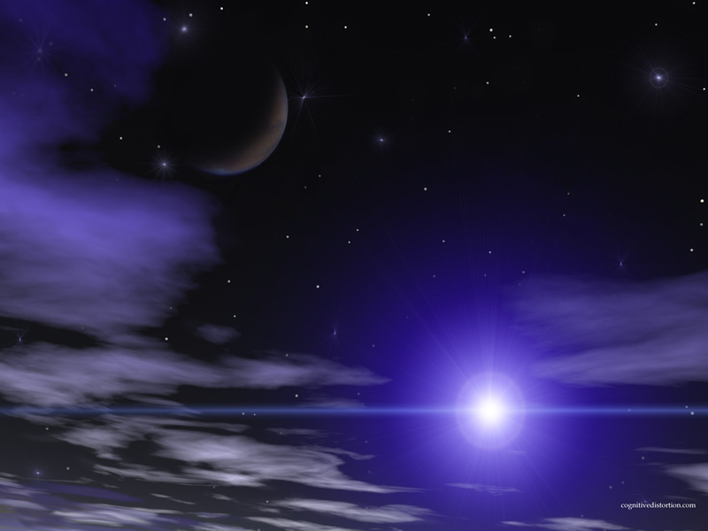
The light coming from the sun, moon, and stars is reduced by a third.

Slide 37
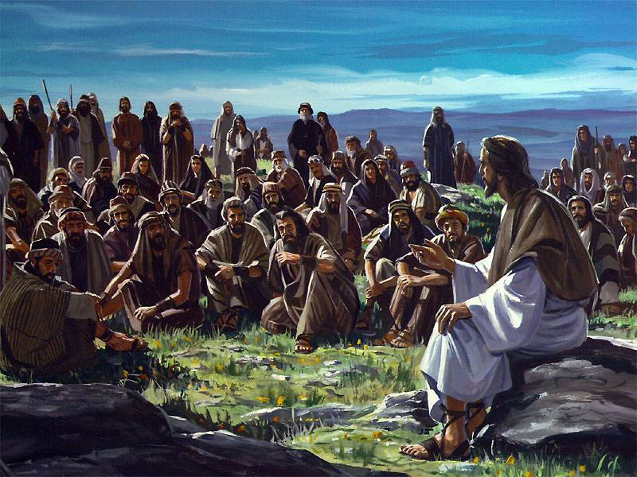
“And there shall be signs in the sun, and in the moon, and in the stars; and upon the earth distress of nations, with perplexity; the sea and the waves roaring. Men’s hearts failing them for fear, and for looking after those things which are coming on the earth: for the powers of heaven shall be.” (Luke 21:25-27)

Slide 38
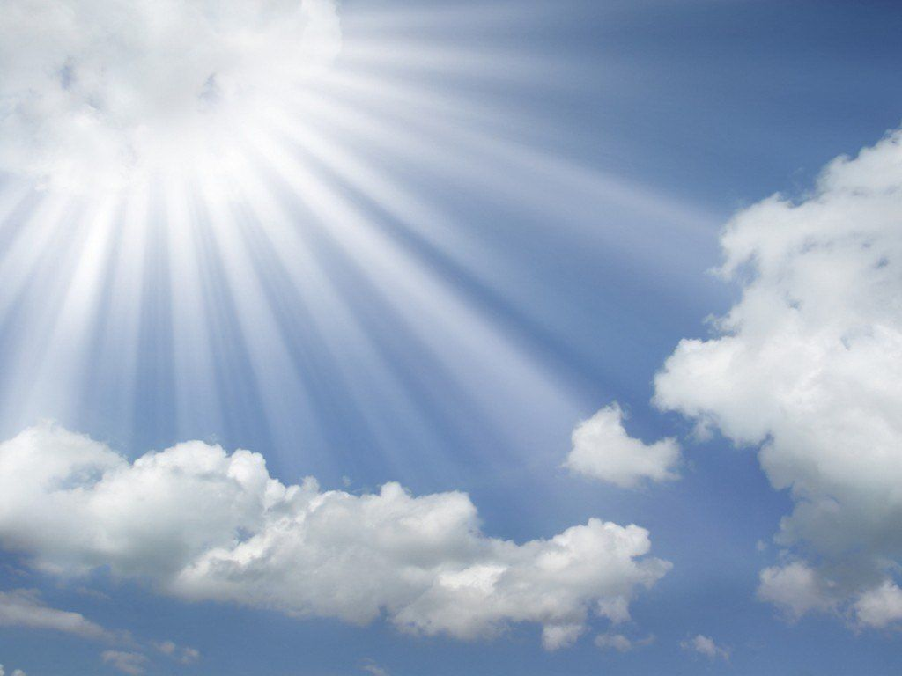
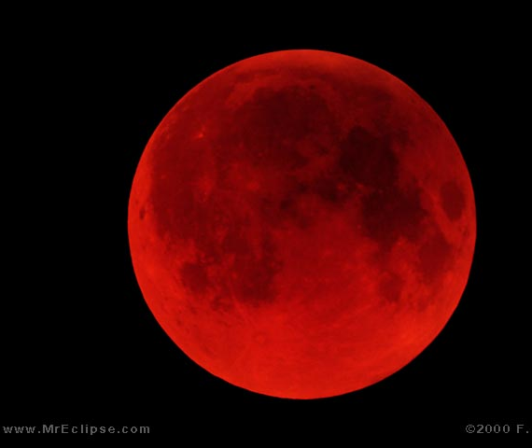

Slide 39
“And I beheld, and heard an angel flying through the midst of heaven, saying with a loud voice.”

Slide 40
“Woe, woe, woe, to the inhabiters of the earth by reason of the other voices of the trumpet of the three angels, which are yet to sound!”

Slide 41
Revelation 9:1-11:19

Slide 43
“For God hath not appointed us to wrath, but to obtain salvation by our Lord Jesus Christ.”
(I Thessalonians 5:9)

Slide 44
“Behold, now is the accepted time; behold, now is the day of salvation.”
(I Corinthians 6:2)

Slide 45
“All these things must come to pass, but the end is not yet. For nation shall rise against nation, and kingdom against kingdom: and there shall be famines, and pestilences, and earthquakes, in divers places. All these are the beginning of sorrows.”

Slide 46
“Men's hearts failing them for fear, and for looking after those things which are coming on the earth.” (Luke 21:26)

Slide 47
“And they shall deliver you up to be afflicted, and shall kill you: and ye shall be hated of all nations for my name’s sake.”

Slide 48
“The sun be darkened, and the moon shall not give her light, and the stars shall fall from heaven, and the powers of the heavens shall be shaken.”
Notes:
en

Slide 49
“Then shall appear the sign of the son of man in heaven…and they shall see the Son of man coming in the clouds of heaven with power and great glory.”

Slide 50
“Behold, He cometh with clouds; and every eye shall see Him, and they also which pierced Him: and all kindreds of the earth shall wail because of Him. Even so, Amen.” (Revelation 1:7)

Slide 51
“All these things must come to pass.”
“What manner of persons ought ye to be in all holy conversation and godliness?”

