Slide 1
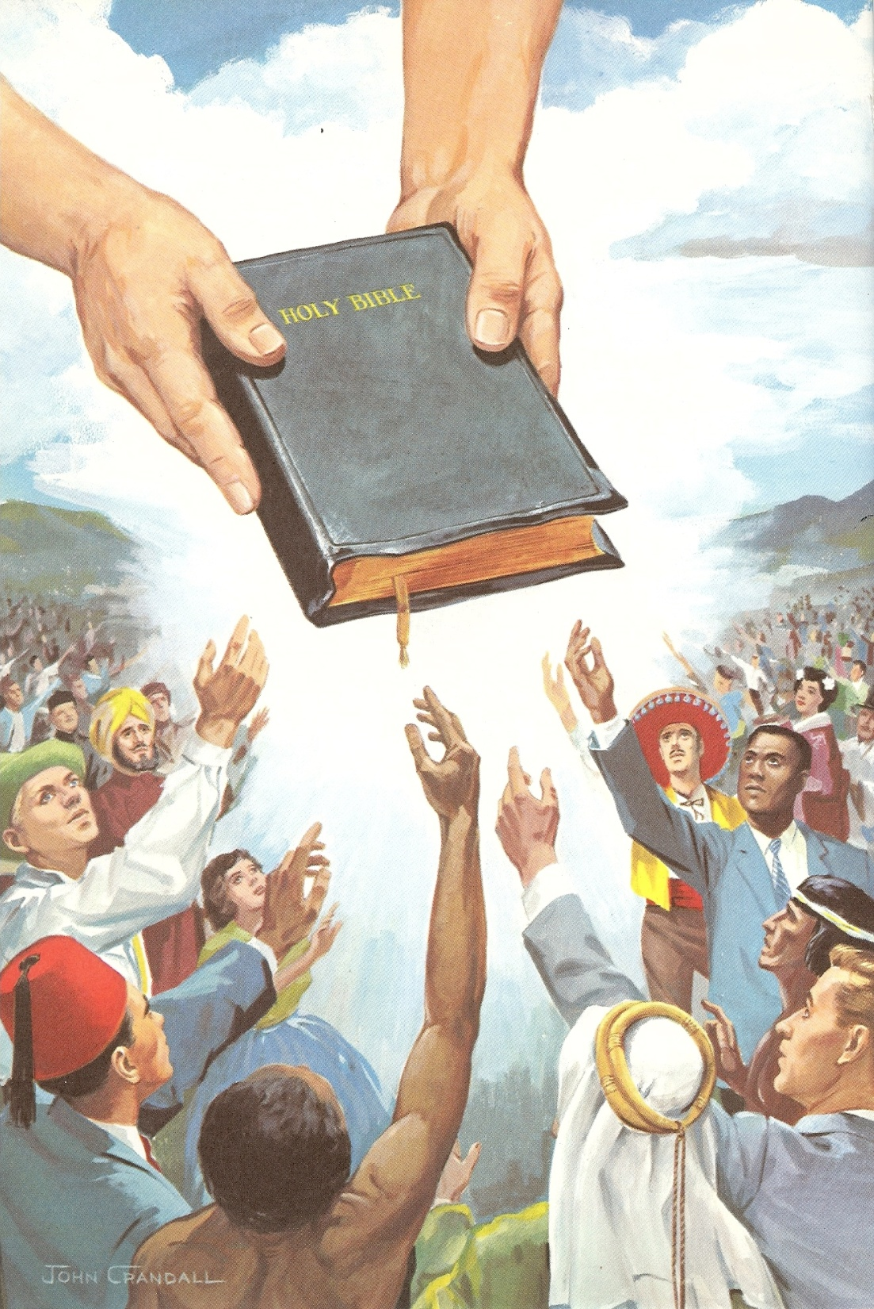
“And he (Jesus) spake many things unto them in parables, saying, Behold, a sower went forth to sow…”

Slide 2
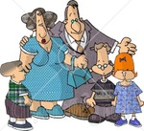
seed
sower
soil

Slide 3
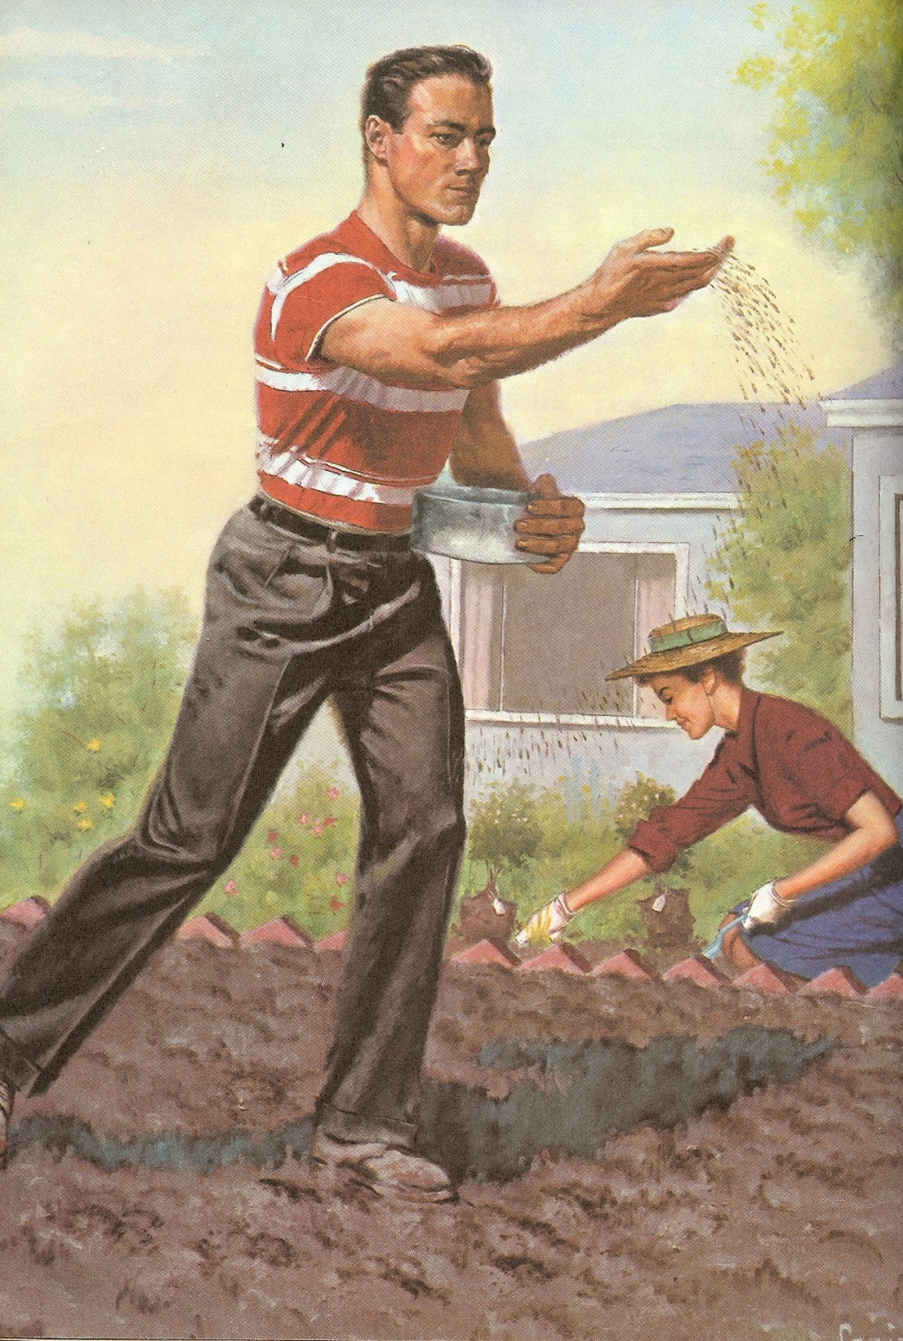

Slide 5
Honor
Serve
Fellowship

Slide 6
Eternal Life

Slide 7
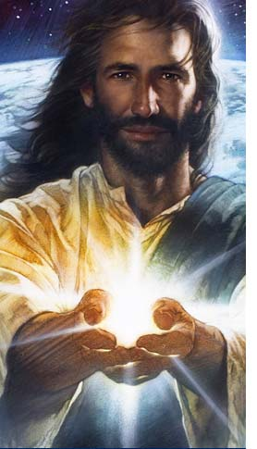
“For by grace are ye saved through faith; and that not of yourselves: it is the gift of God.” Eph. 2:8

Slide 8
“Not by works of righteousness which we have done, but according to his mercy he saved us.” Titus 3:5

Slide 9
“But God commendeth his love toward us, in that, while we were yet sinners, Christ died for us.” Rom. 5:8

Slide 10
“And this is the record, that God hath given to us eternal life, and this life is in his Son” I John 5:11

Slide 11
