Slide 2
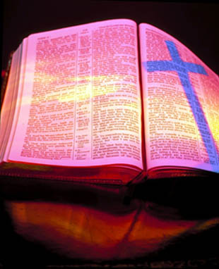
Revelation 1:1-19 The Vision of the Glorified Christ

Slide 3
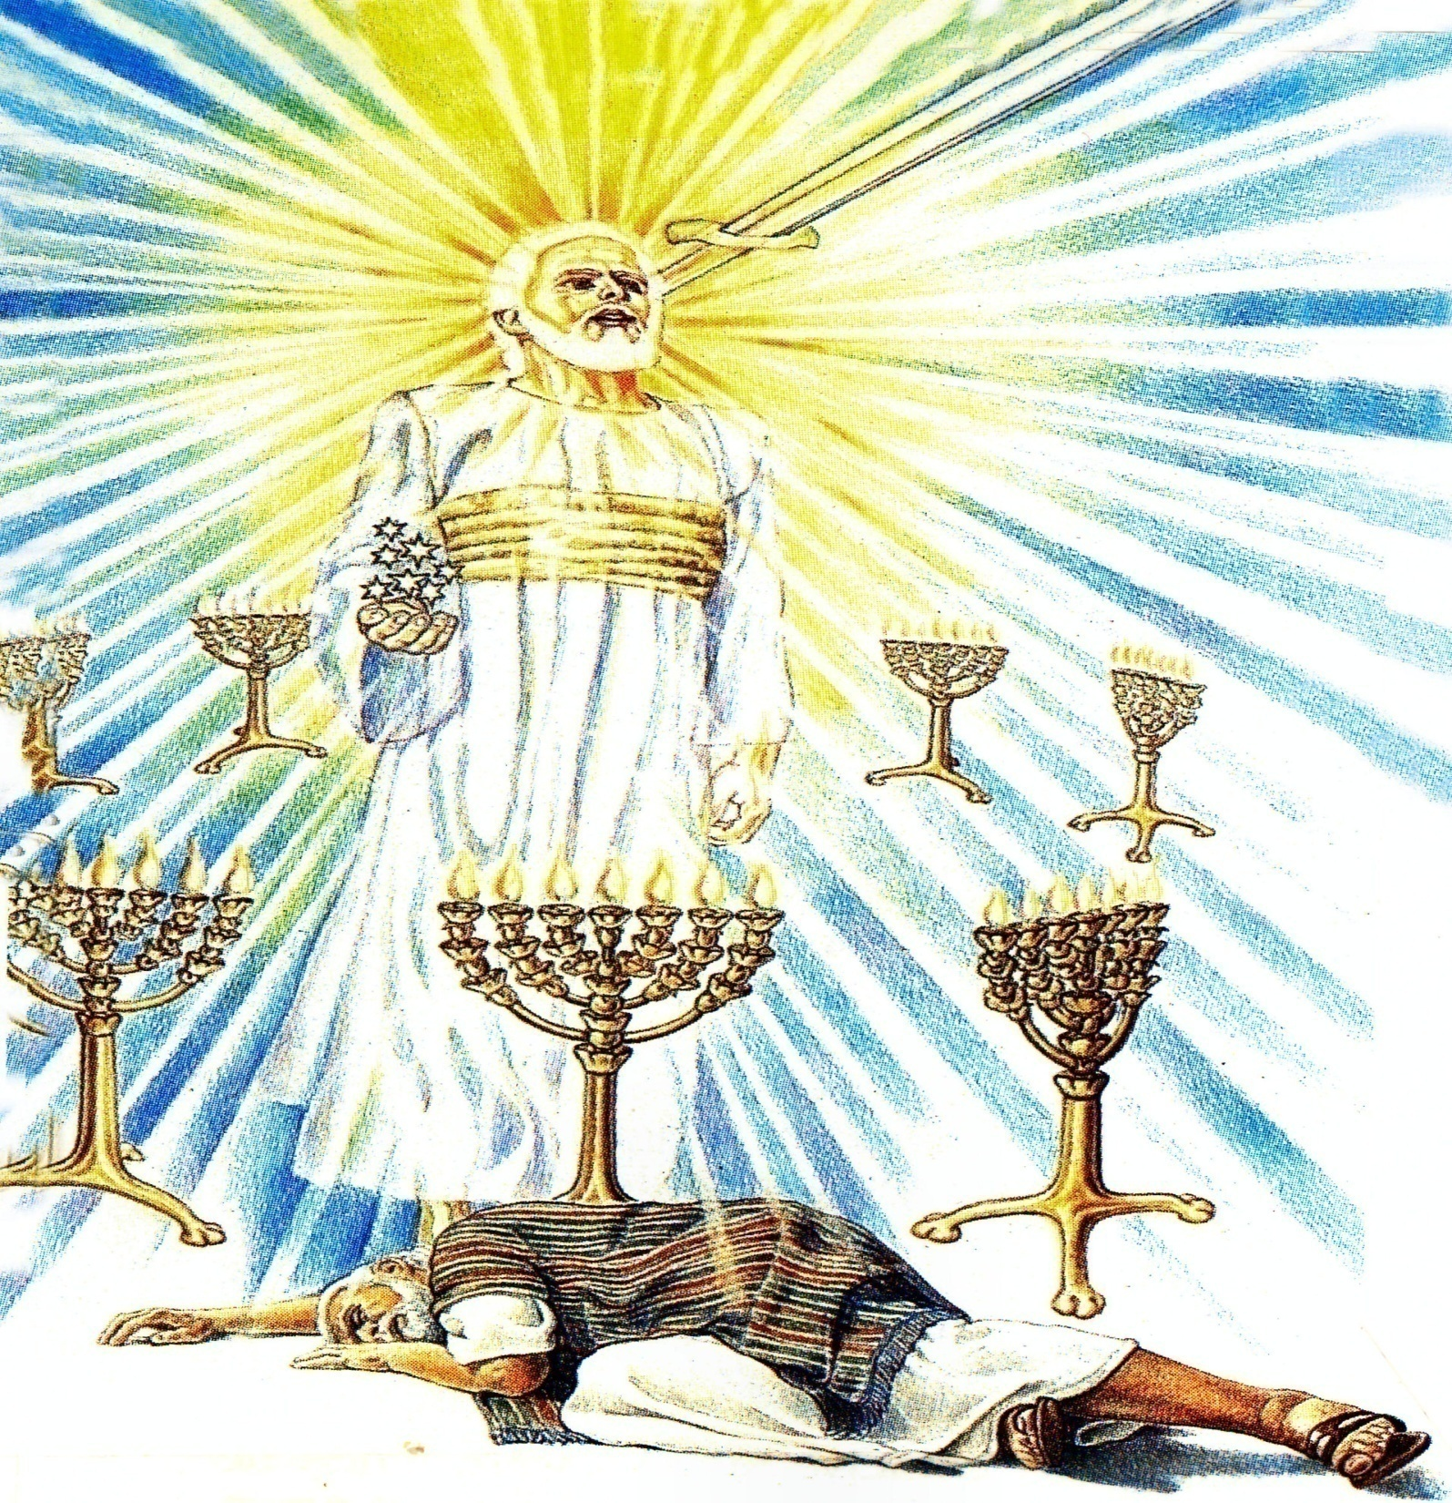

Slide 4
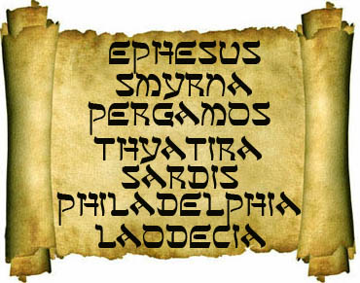
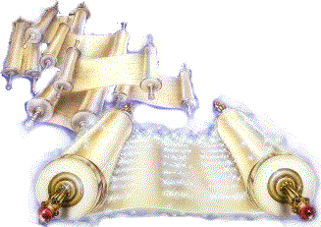
“What thou seest, write in a book, and send it unto the seven churches which are in Asia; unto Ephesus, and unto Smyrna, and unto Pergamos, and unto Thyatira, and unto Sardis, and unto Philadelphia, and unto Laodicea.”

Slide 5
Revelation 2:1-7 The Church at Ephesus

Slide 7
Revelation 2:8-11
“The Church at Smyrna”

Slide 9
Revelation 2:12-17
“The Church at Pergamos”

Slide 10
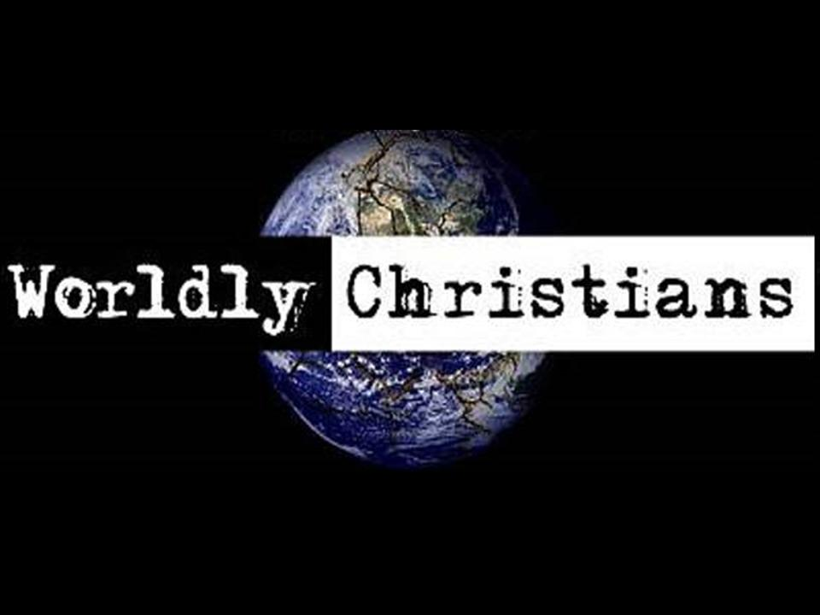

Slide 11
Revelation 2:18-29
“The Church at Thyatira”

Slide 12
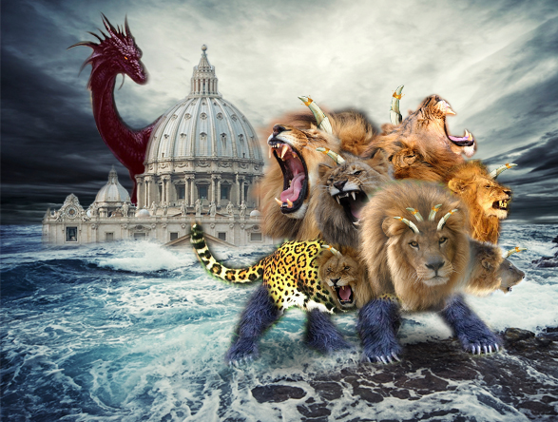
The Church that Became Pagan

Slide 13
Revelation 3:1-6
“The Church at Sardis”

Slide 14
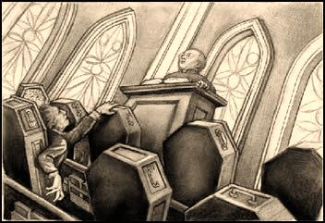
The Spiritually Dead Church
“…thou hast a name that thou livest, and art dead.”

Slide 15
Revelation 3:7-13
“The Church at Philadelphia”

Slide 16
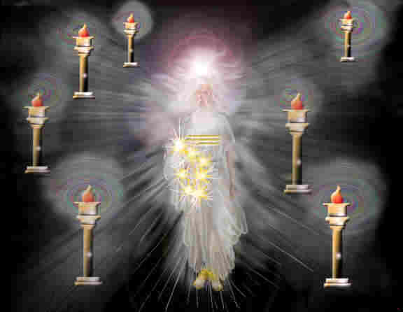
Signs of Christ’s Return (Church age)
Ephesus – Fundamental - A.D. 30-100
Smyrna – Persecuted – A.D. 100-312
Pergamos – Worldly – A.D. 312-606
Thyatira – Pagan – A.D. 606-1520
(Dark Ages)
Sardis – Spiritually Dead – A.D. 1520-1750
Philadelphia – Revival – A.D. 1750-1900
Laodicea – Apathy – A.D. 1900-Rapture

Slide 17
“And to the angel of the church in Philadelphia write; These things saith he that is holy, he that is true, he that hath the key of David, he that openeth, and no man shutteth; and shutteth, and no man openeth.”

Slide 18
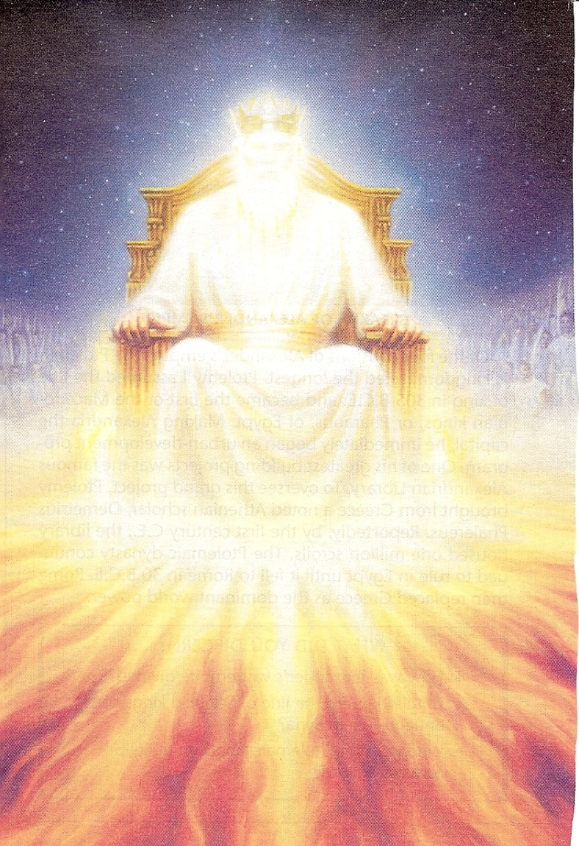
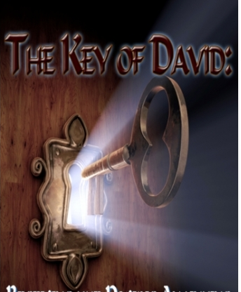
Holy
True
Sovereign

Slide 19
(Isaiah 22:22)
“And the key of the house of David will I lay upon his shoulder; so he shall open, and none shall shut; and he shall shut, and none shall open.”

Slide 20
The term the key of David also appears in Isaiah 22:22, where it refers to Eliakim, the steward or prime minister to Israel's king. Because of his office, he controlled access to the monarch. As the holder of the key of David, Jesus alone has the sovereign authority to determine who enters His messianic kingdom (John 10:7, 9; 14:6; Acts 4:12). Revelation 1:18 reveals that Jesus has the keys to death and hell; here He is depicted as having the keys to salvation and blessing.

Slide 21
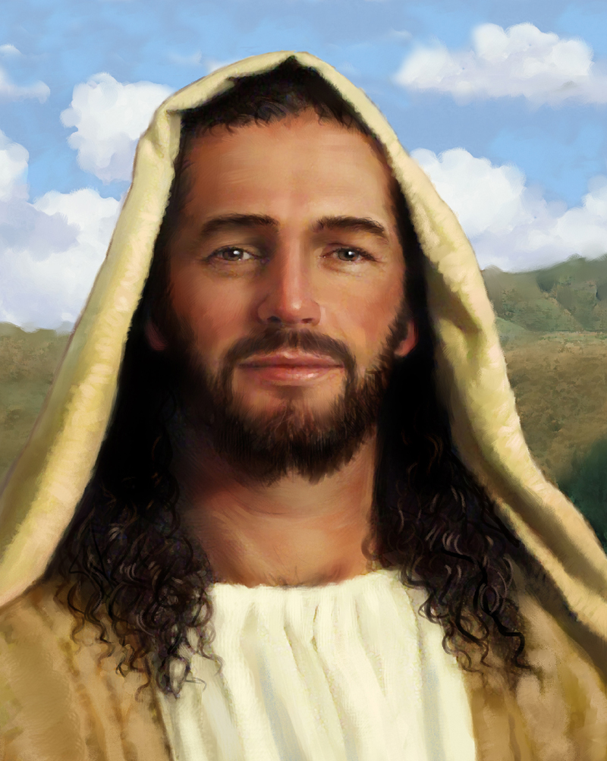
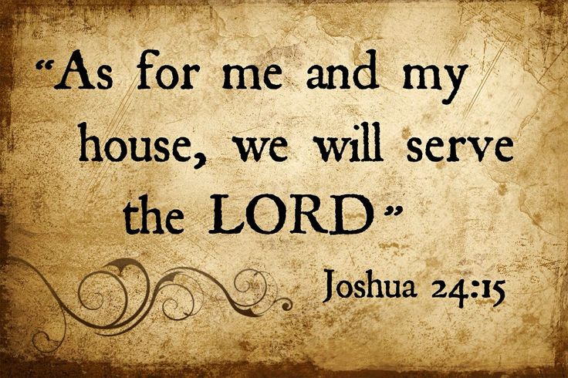
“I know thy works…”

Slide 22
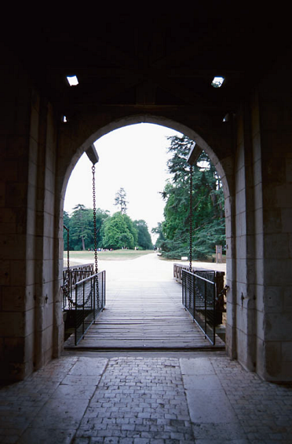
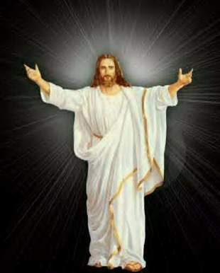
“I have set before thee an open door, and no man can shut it.”

Slide 23
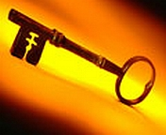
Discerning Open Doors
No compromise involved
In accordance with the Word of God
Advances the Kingdom of God (Salvation and Spiritual Growth)
Always under authority
Requires faith
Brings Glory to God

Slide 24
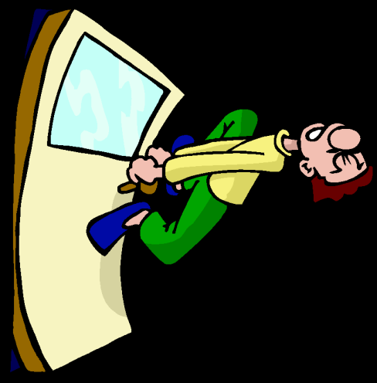

Slide 25
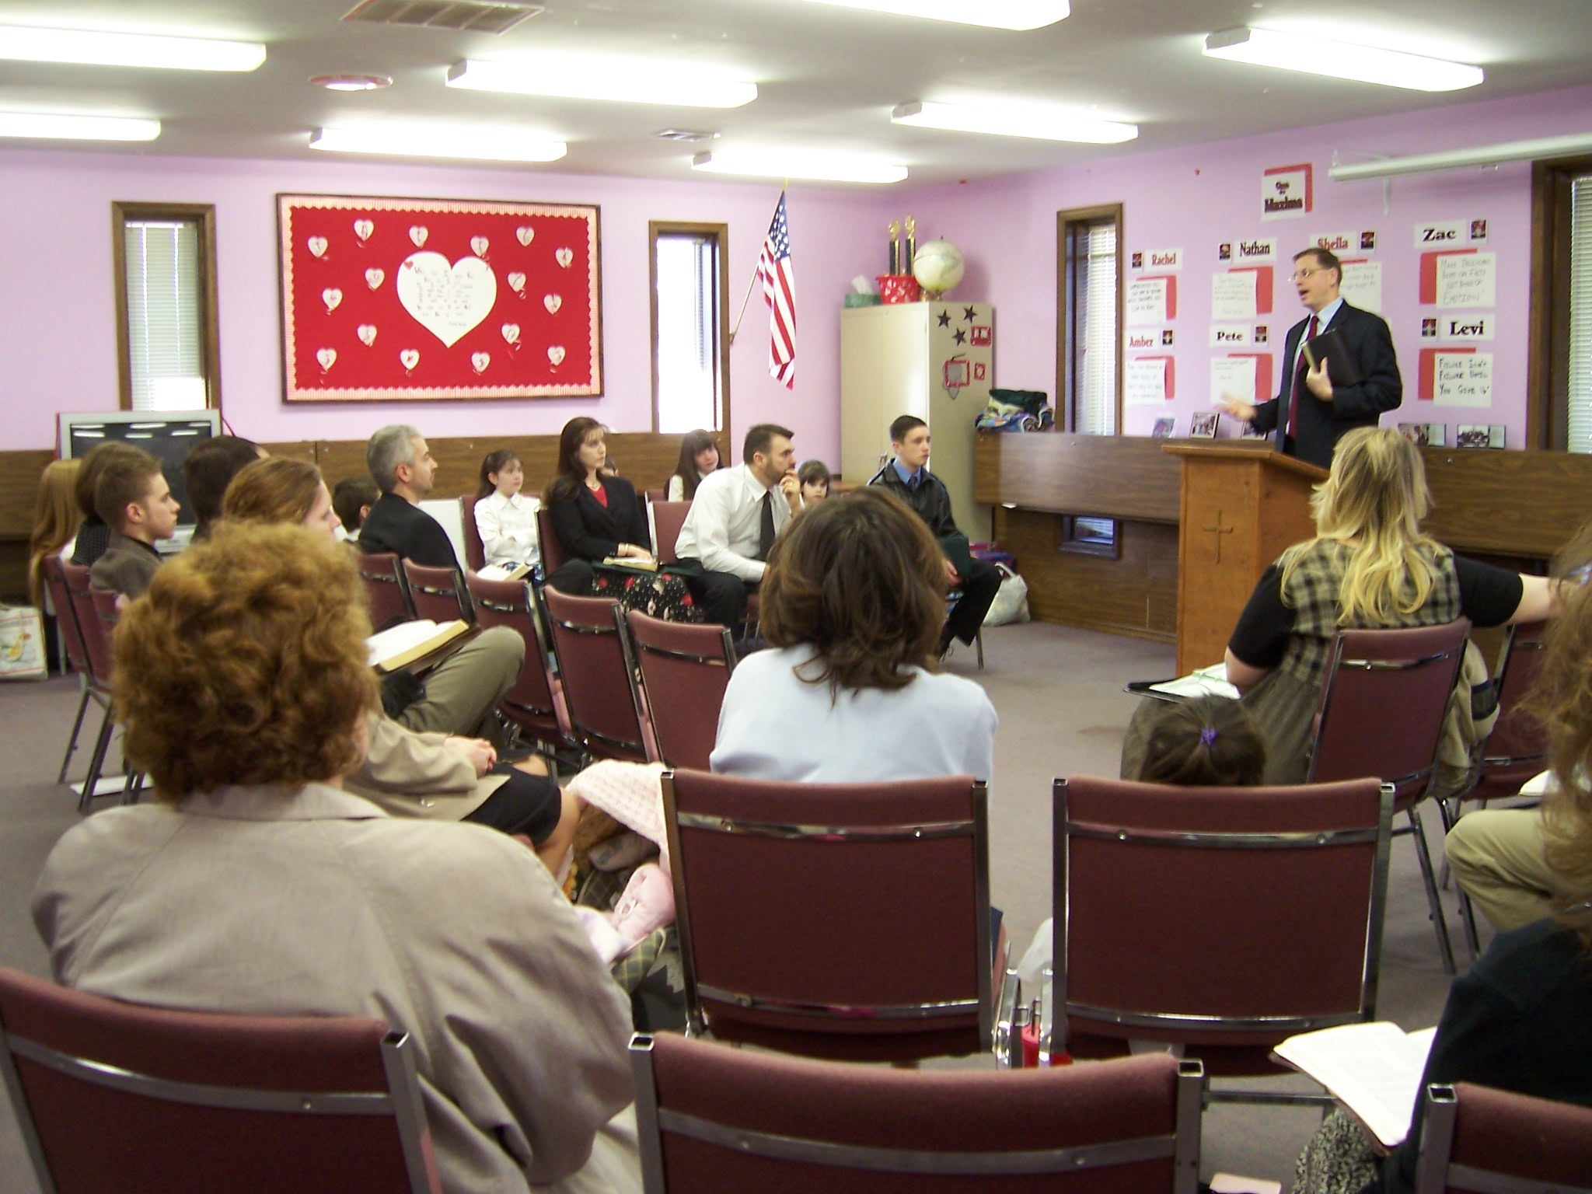
“Thou hast little strength…”

Slide 26
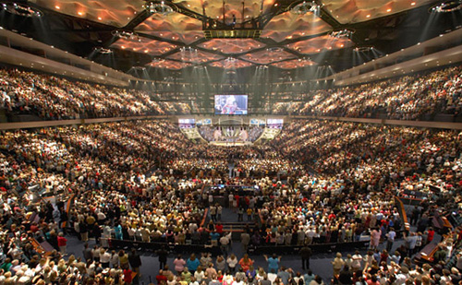

Slide 28
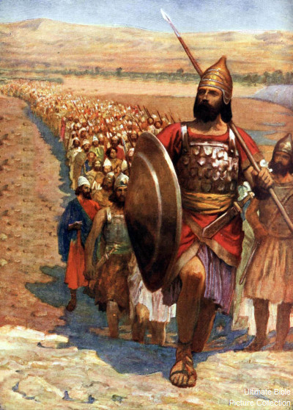

Slide 29
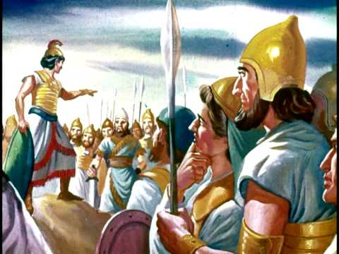

Slide 30
(Judges 7:3) “Now therefore go to, proclaim in the ears of the people, saying, Whosoever is fearful and afraid, let him return and depart early from mount Gilead. And there returned of the people twenty and two thousand; and there remained ten thousand.”

Slide 31
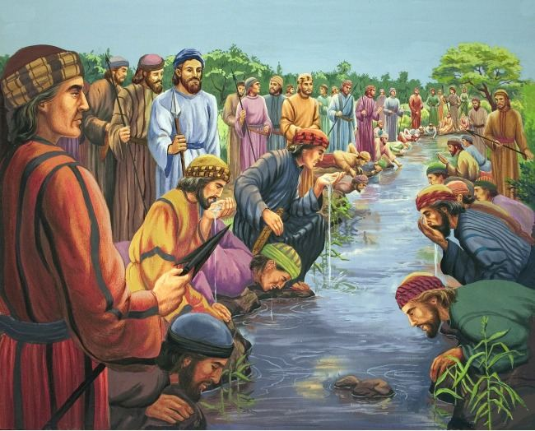

Slide 32
(Judges 7:6) “And the number of them that lapped, putting their hand to their mouth, were three hundred men: but all the rest of the people bowed down upon their knees to drink water.”

Slide 33
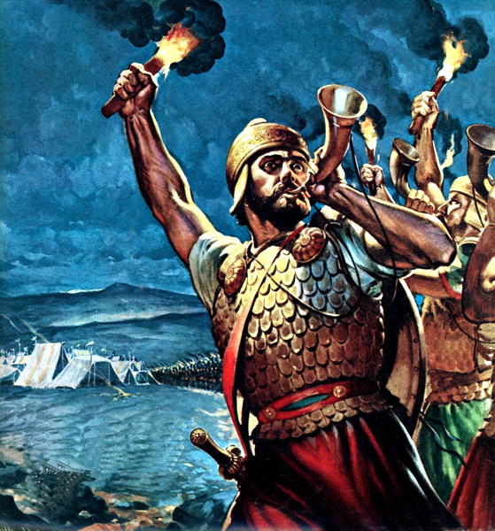

Slide 34
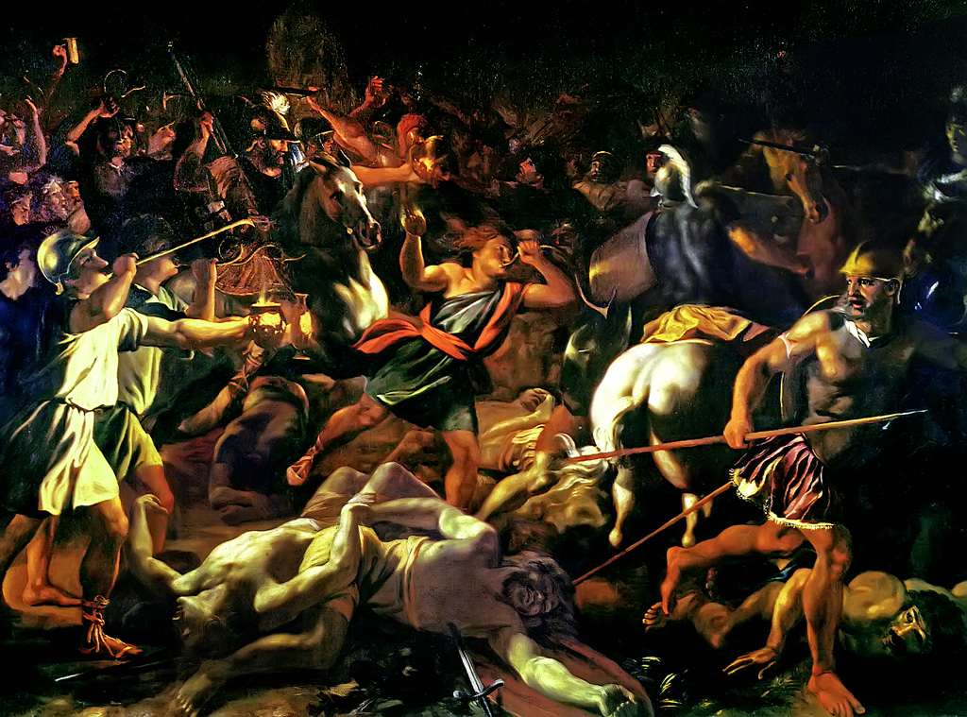

Slide 35
“Thou hast kept my Word…”

Slide 36
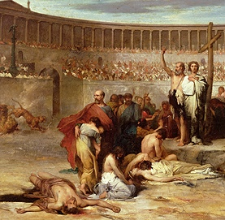
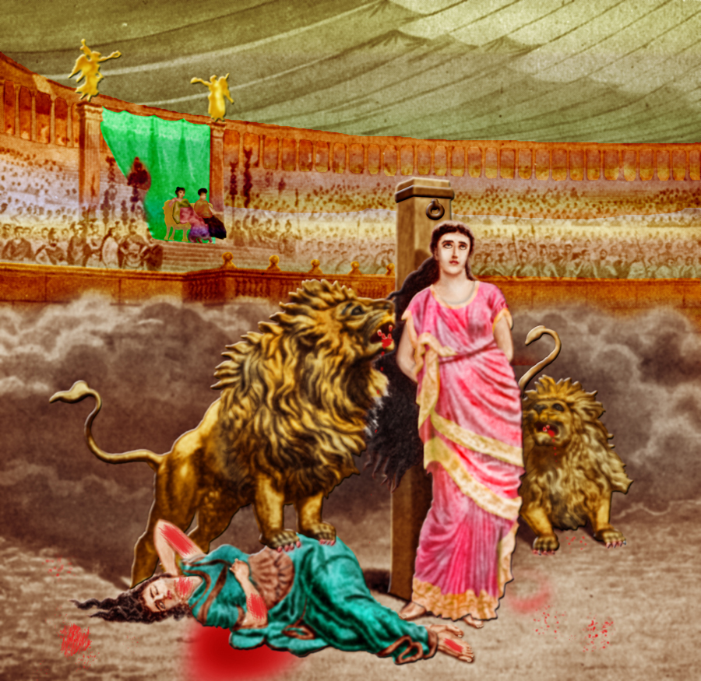
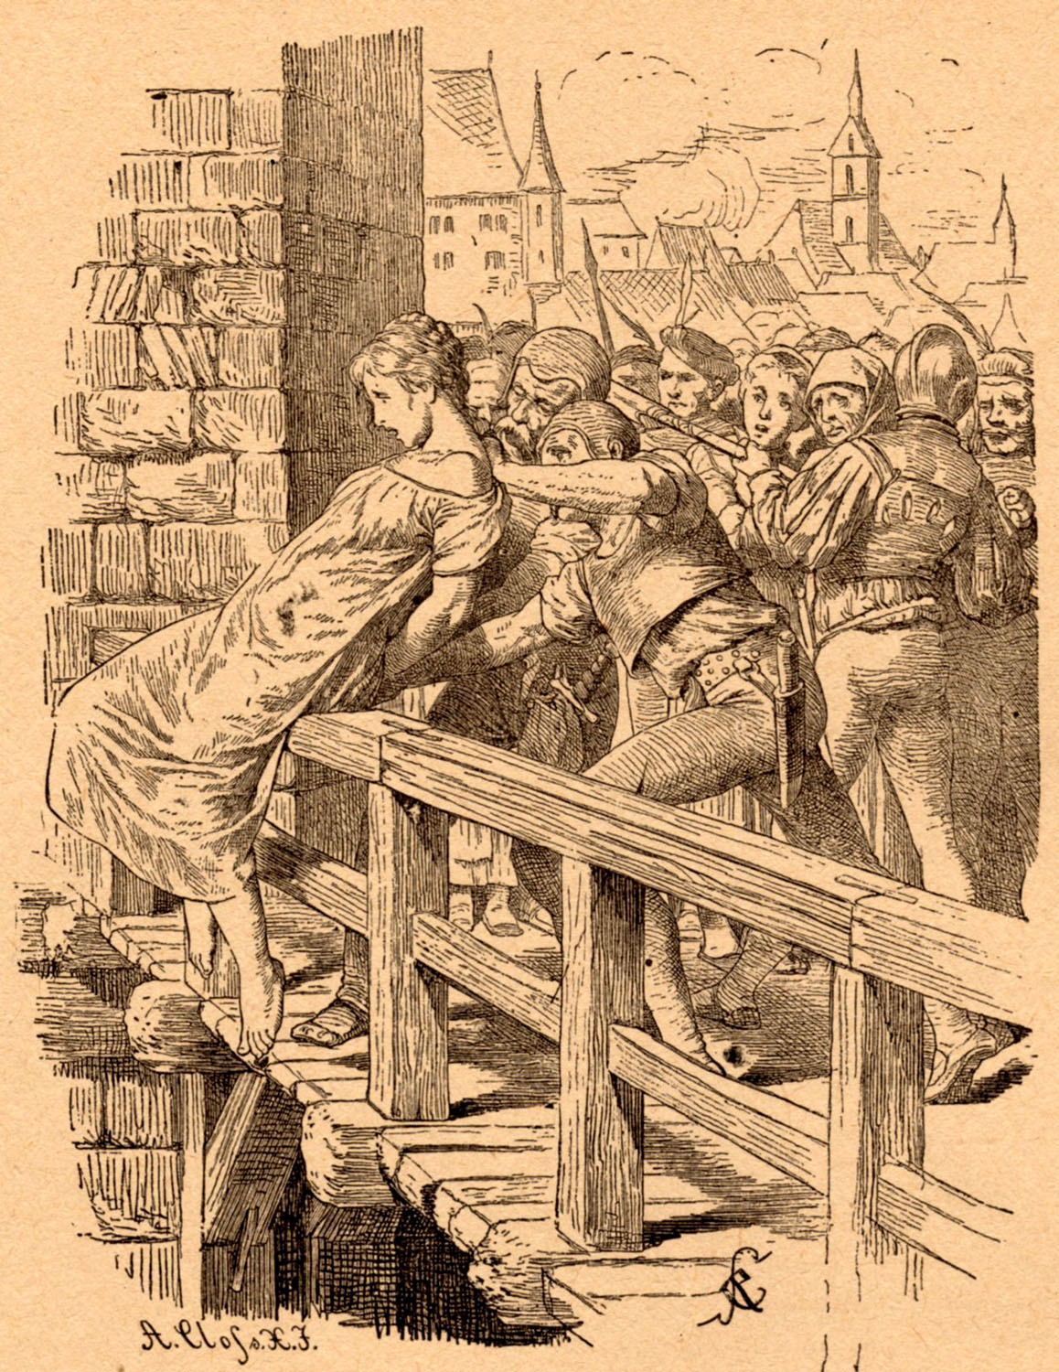
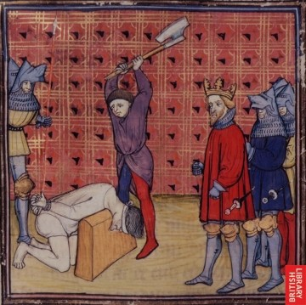
“Thou hast not denied my name…”

Slide 37
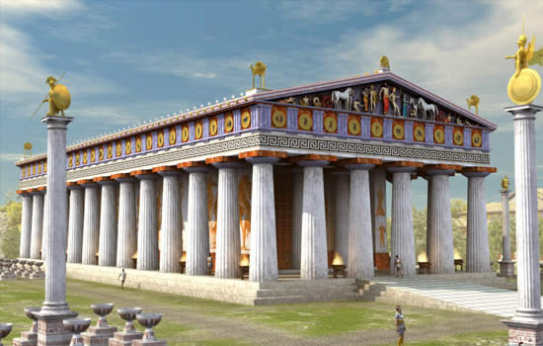
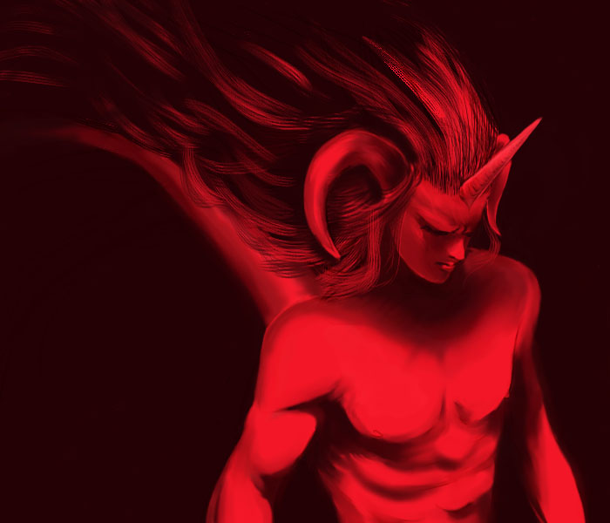
“Behold, I will make them of the synagogue of Satan, which say they are Jews, and are not, but do lie; behold, I will make them to come and worship before thy feet, and to know that I have loved thee.”

Slide 39
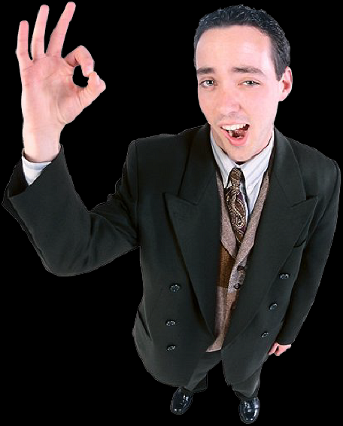
“They profess that they know God; but in their works they deny him, being abominable (unlawful), and disobedient, and unto every good work reprobate.” (Titus 1:16)

Slide 40
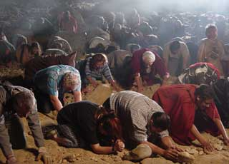
“I will make them to come and worship before thy feet…”

Slide 42
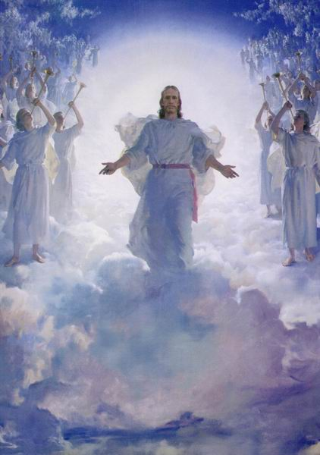
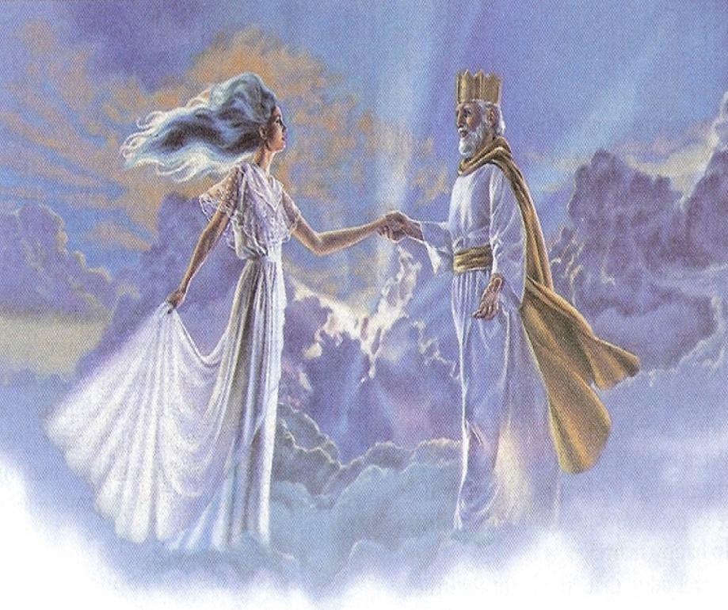
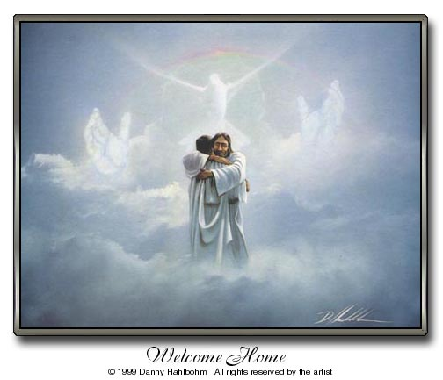
“I have loved thee…”

Slide 43
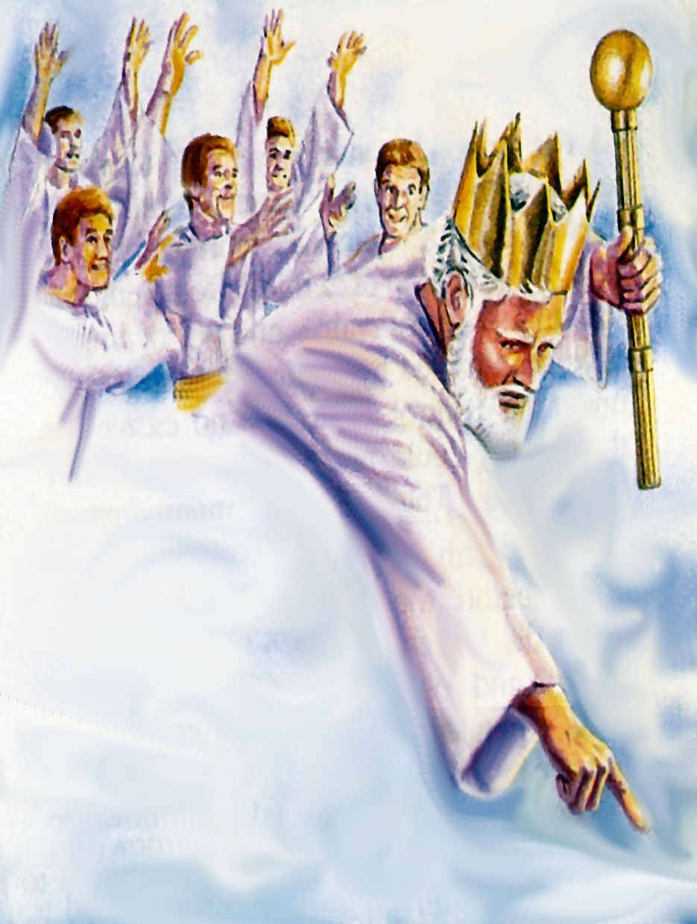
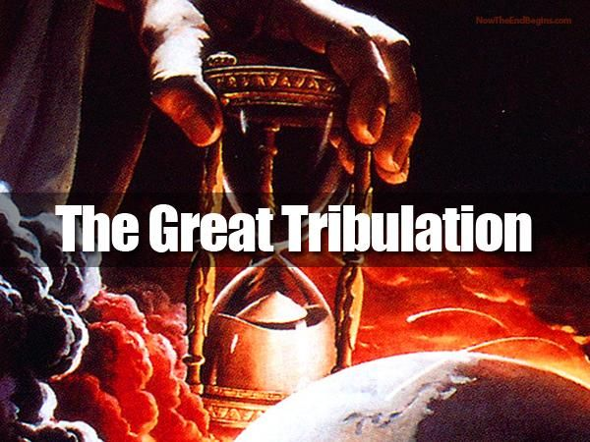
“I will keep thee from the hour of temptation…”

Slide 44
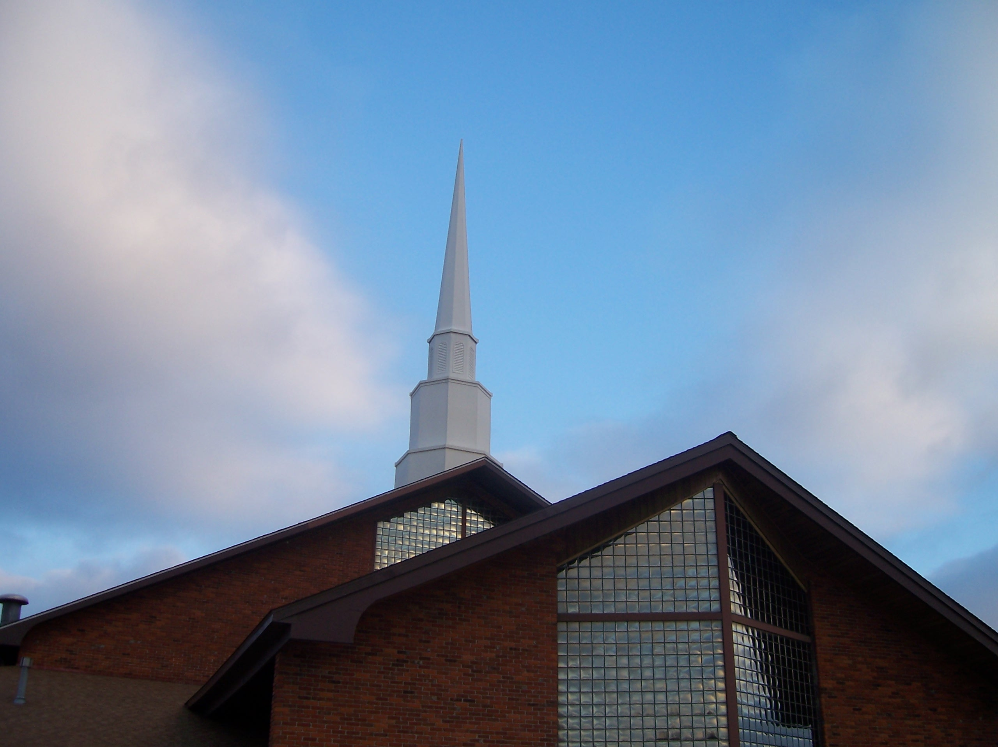
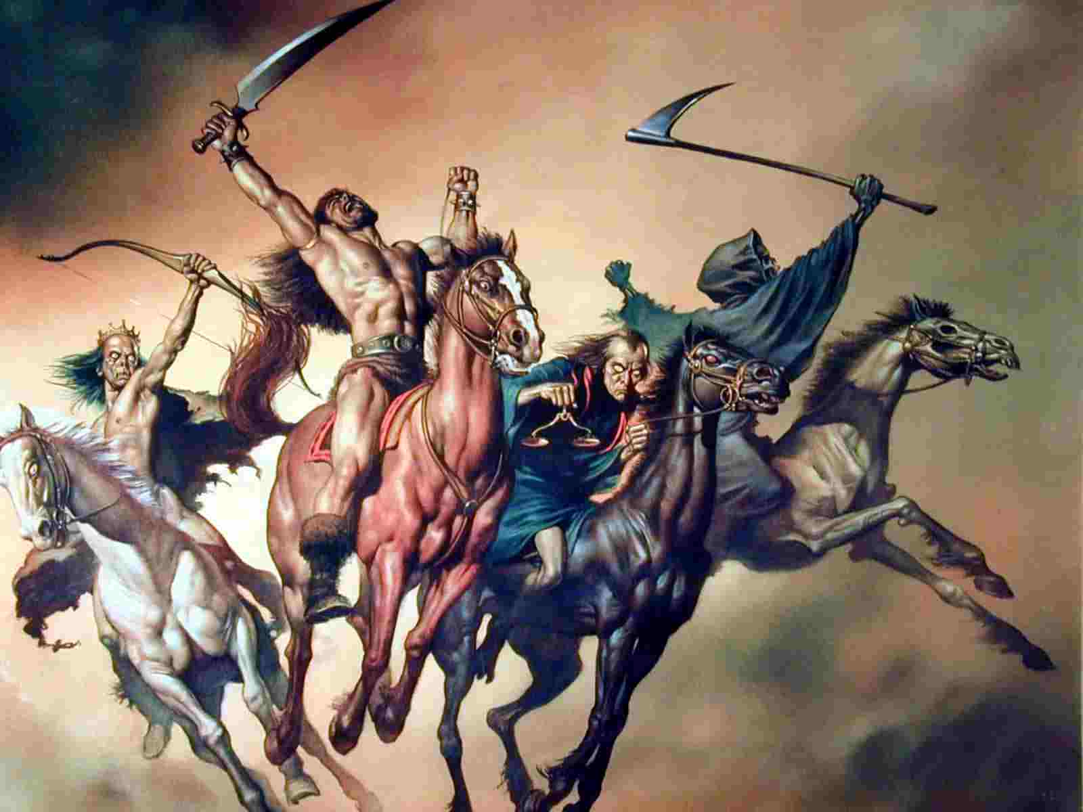
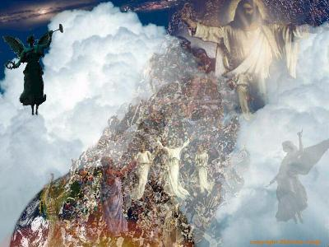
“Behold, I come quickly.”

Slide 47
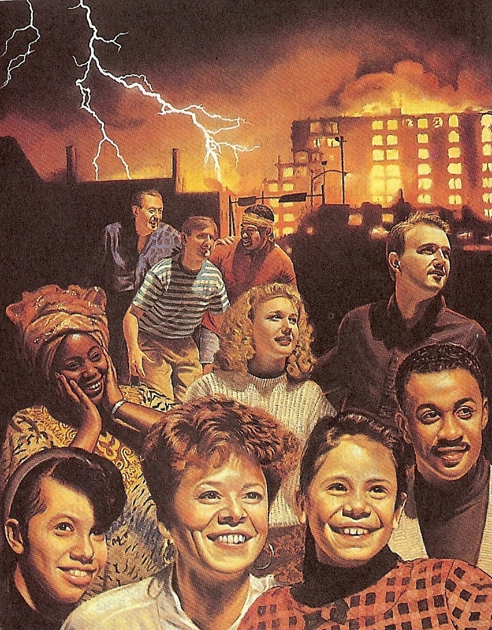
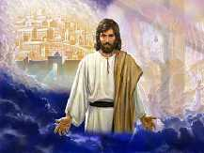
“For God hath not appointed us to wrath, but to obtain salvation by our Lord Jesus Christ…”

Slide 48
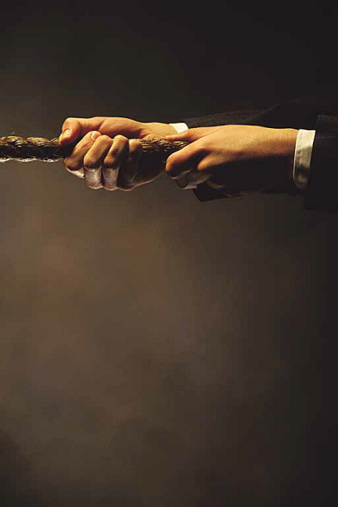
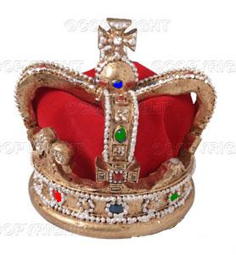
“Hold Fast…”
“…THAT NO MAN TAKE THY CROWN…”

Slide 49
Crown of righteousness (for all those who love the appearing of Jesus Christ)
Crown of life (for those who faithfully endure times of suffering and hardship for Christ)
Crown of glory (for faithful pastors)
Crown of rejoicing (for soul winners)
Incorruptible crown (for those who faithfully run the race and fight the fight)

Slide 50
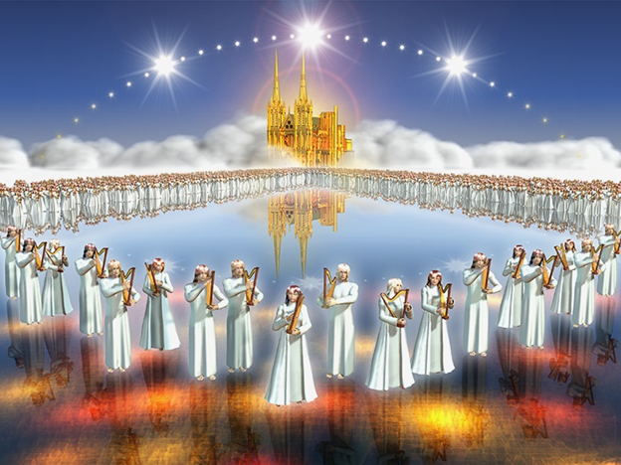
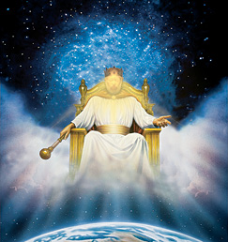

Slide 51
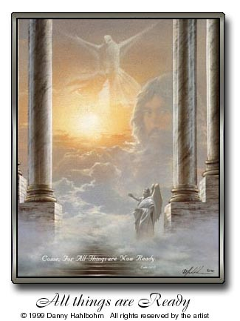
“Him that overcometh will I make a pillar in the temple of my God, and he shall go no more out.”

Slide 52
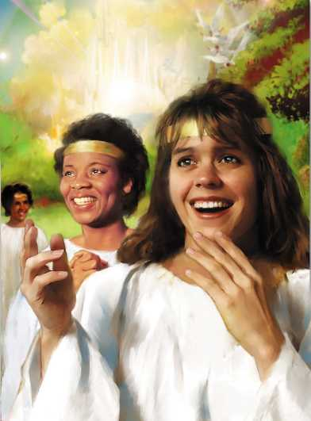
“…and I will write upon him the name of my God...and I will write upon him my new name.”

Slide 53
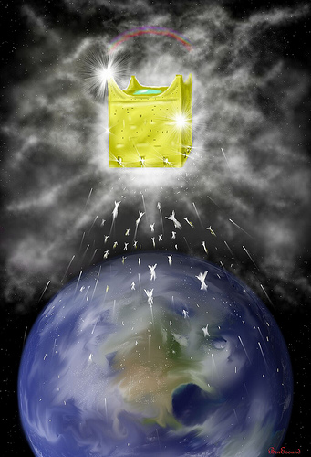
“…and the name of the city of my God, which is new Jerusalem.”

Slide 54
“I will write upon him…” (Guarantee of Eternal Security)
“The name of my God…” (Ownership)
“The name of the city of my
God…” (Heavenly Citizenship)
“I will write upon him my new
name…” (Joint heirs with Christ)

Slide 55
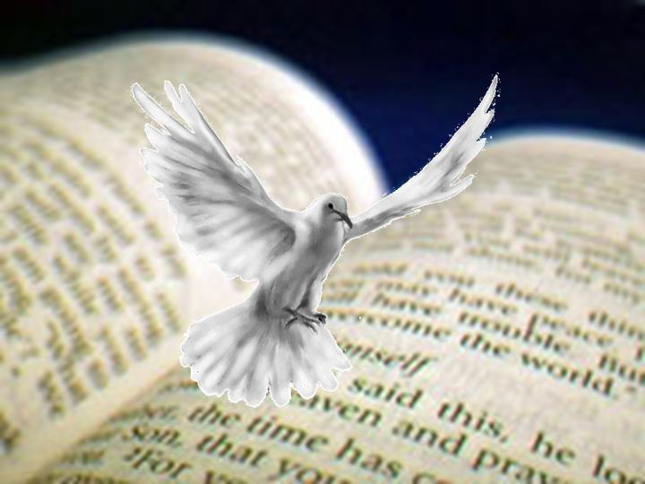
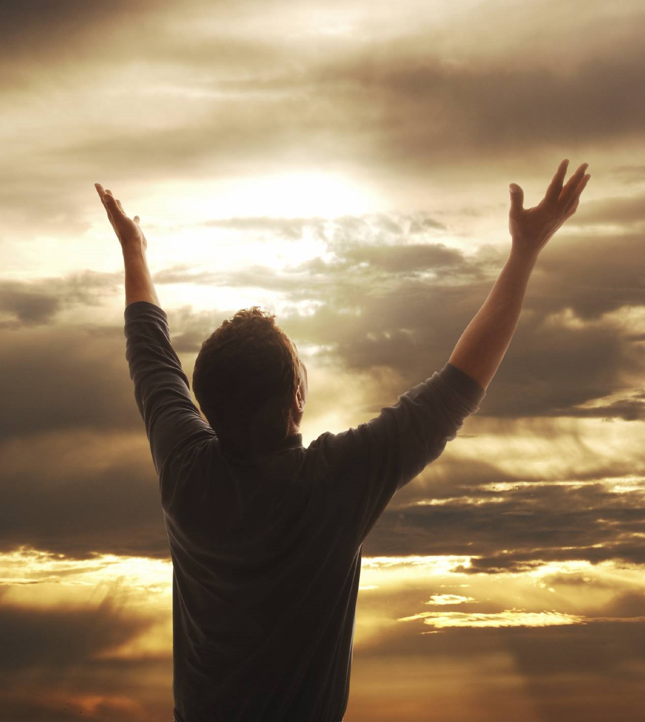
“He that hath an ear, let him hear what the Spirit saith unto the churches.”

